Slide 1
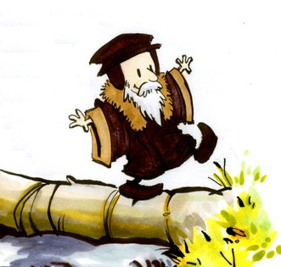
Religion:
Free Will &
Determinism
(c) P Allen

Slide 2
Determinism: The view that every event has a cause and so, when applied to moral decisions we do not have free will.
The concept of determinism spans history and can be found in every aspect of life from science to philosophy to theology. When it comes to human actions and morality, it is best contrasted against the notion of free will.
For many, there exists an important relationship between freedom and moral responsibility. As it is commonly believed that we should be morally responsible for actions, which are freely performed, most would agree that we should accept the blame for the things we freely do wrong.
Within traditional Judeo-Christian theology, God gave humanity the ability and right to make their own choices. Within the story of Adam and Eve the first created humans could only be morally responsible, and thus blameworthy, for their actions, if they had the ability to choose one action over another. The theory being without free will, God could not justly commend or condemn the actions of humanity.

Slide 3
Free Will: The view that humanity is free to choose their actions and are thus morally responsible for those actions.
The argument that free will is required to make moral choices raises the issue of responsibility.
The moral judgment that you should not have done X implies that you should have done something else instead.
That you should have done something else instead implies that there was something else for you to do.
That there was something else for you to do implies that you could have done that something else.
That you could have done something else implies that you have free will.
If you do not have free will to have done other than X we cannot make the moral judgment that you shouldn't have done X.
If you do have free will to do other than X then we can make the moral judgment that you should do other than X.

Slide 4
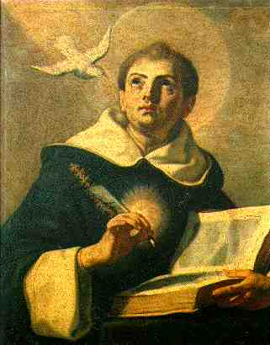
Aquinas believes the choice made by Adam and Eve were freely made and not determined by some theistic design.
‘Man chooses not of necessity but freely.’
St Thomas Aquinas, Summa Theologica.
In using the word ‘necessity’ Aquinas means to suggest one
would have no other choice. Conversely the word ‘freely’ implies total choice.
The issue with Free Will
Traditional theism teaches the Christian God is omniscient (all-knowing) and must, therefore, be knowledgeable of all that is in the past, happening in the present and going to happen in the future.
Q. What might be the problem this raises for the Christian who believes God gave humanity free will, and thus, freedom over their choices?

Slide 5
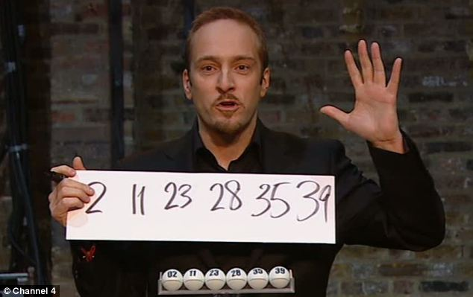
Some argue, if God knows all the things in the future, then he knows the choices we will make, as such we are bound by Gods knowledge and thus are determined to make those decisions at the time we come to the point of choice. This in turn means we have no real choice but to make the choice God knew we would.
However, it could equally be argued;
God’s knowledge of something doesn’t
need imply God’s involvement. Consider
a mystic claiming to have foreseen te
lottery numbers that will be drawn that
weekend.
Lets now further assume those
particular numbers are actually the ones
drawn. Does this imply an involvement
on the part of the mystic in what numbers
are actually drawn?
No. There is nothing
to imply the mystic has, by some supernatural power, forced these numbers to be drawn, only that they are, at best, some casual observer into a moment in time.
Likewise, there are those who argue God’s knowledge of what you will do, does not determine that you will do it, it merely offers an observation of the events chosen by you in a moment in time.

Slide 6
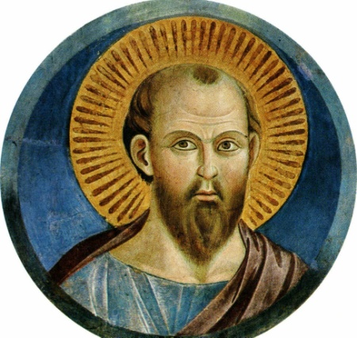
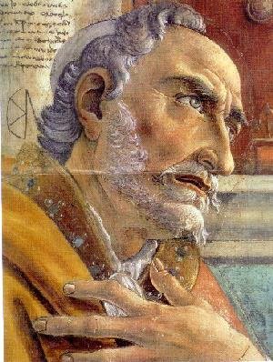
Religious Determinism:
Many of the world’s religions have specific beliefs about how all things are determined by God through the actions and events that surround us.
There are within Christianity, specifically protestant Christianity, those who believe God has already determined all things, including those who will be ‘saved’ at the end of time and spend eternity with God in heaven, and those who will not.
‘Those God foreknew he also predestined to be conformed to the likeness of his Son... And those predestined, he also called; those he called, he also justified; those he justified, he also glorified.’
St Paul (Romans 8: 28-30)
‘The potter has authority over the clay from the same lump to make one vessel for noble purposes and another for ignoble.’
St Augustine of Hippo (354 - 430AD)

Slide 7
Predestination: The belief that God has decided before time who will be saved and who will not.
Those who propose predestination, also known as theological determinism, hold the belief in the total irrelevance of our actions in this life as God has already decided whether we are (note not ‘are to be ’) saved or not saved.
Interestingly, the belief in predestination relies more on ‘special revelation’ from God, more than it does astringent theological study of scripture. However, it does turn to passages such as St Paul’s to the Romans for support.
It is by this same revelation that certain individuals within humanity are saved. St Augustine believed humanity requires the direct help of God in order to do good, this ‘help’ (God revealing to you what is the right thing to do and enabling you to do it) is not earned by merit but is a free gift from God – by His grace alone (sola gratia). Consequentially, God alone determines who will receive this grace, which in turn assures salvation.
However, this does seem to imply while there are those who are predestined for salvation, there must be those who are predestined for damnation. A concept incompatible with God to theologians such as Pelagius, but not to Calvin.

Slide 8
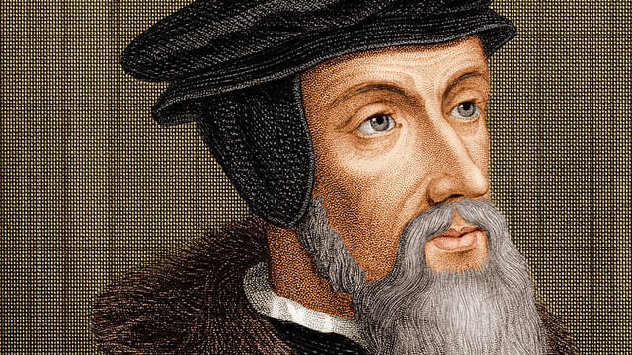
John Calvin (1509-1564):
‘Eternal life is fore-ordained for some, and eternal damnation for others. Every man, therefore, being created for one or other of these ends... is predestined to life or death.’
John Calvin (Institutes of the Christian Religion)
Calvin started from the belief that not only is every man a complete sinner but that they are incapable of coming to God and has a sinful free will that is only capable of rejecting God and choosing sin. As such, predestination must occur otherwise nobody would ever be saved and all would be damned. This led Calvin to propose that not all humans are created with the same destiny.
Salvation is by grace alone, not merit, God does not look into the future to see who will follow him, rather, this is predetermined before time began. Those who are saved, do what is right choose to do what is right because God made them that way; the rest are limited by their natural sinful nature and can only choose to be sinful.

Slide 9
Calvin’s concept of predestination:
Total Depravity: This means that sin is in every part of one's being, body, mind, intellect and soul; all is spiritually dead, as such, man cannot save himself.
Unconditional Election: God elects (chooses) to soften the hard, sin-enslaved hearts of certain individuals. He changes their hearts despite themselves not by any merit that may make their salvation otherwise conditional on their own actions.
Limited Atonement: While Christ's blood) is infinitely intensive in its saving power and therefore unlimited in that sense, it is not infinitely extensive and is only available for the elect, and is thus limited,
Irresistible Grace: It is by God’s grace alone (sola gracia) that man is saved, God’s grace is sufficient and man cannot add anything of merit to it (e.g. cooperation). Furthermore, those elected, cannot help but respond positively to God’s salvation.
Perseverance of the Saints: God will sustain the faith of the believer, that saving relationship with Christ, causing them, by His grace, to persevere in faith. Those who do not persevere in the faith, were never truly part of the elect in the first place.

