Slide 1
What are Inductive arguments?
Who stole Ms Choudhury’s stapler? It was last seen an hour ago in 1321
Was it Mr Smith? He always loses stationary and is a few doors apart
Was it Ms Cook ? Her long stapler is so heavy , Ms Choudhury’s Stapler is the right weight to staple exam papers!
Was it Ms Lymer? She loves marking and had run out of staples this morning!
Or is there another suspect…….?
Clues
Photos

Slide 2
What are Inductive arguments?
You have induct a judgement, based on evidence and experiences. Your conclusion reached via inductive proof. We use empirical proof to come up with logical reasoning. The inductive proofs are a posteriori as they require evidence and experience. This applies to Cosmological and Teleological arguments for the existence of God.

Slide 3
Keyword Test

Slide 4
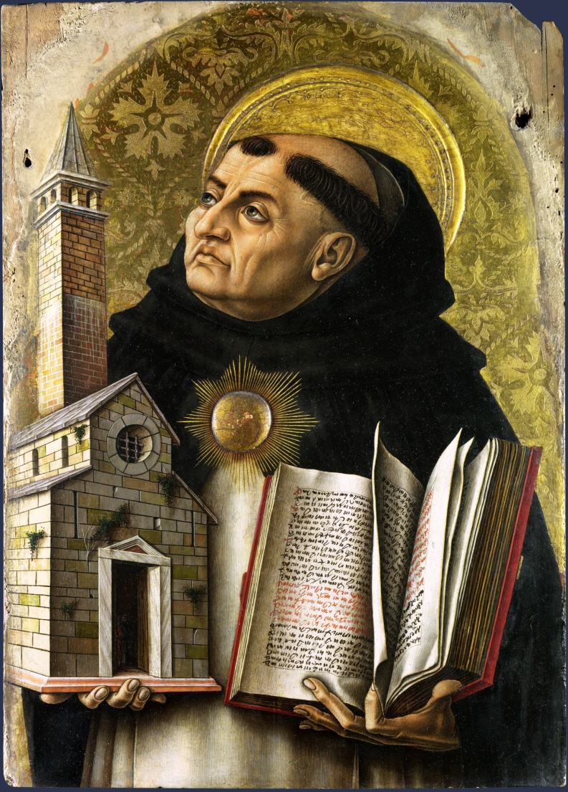
St Thomas Aquinas
St Thomas Aquinas believed that the universe had a beginning, he argued that, as things cannot cause themselves to come into existence, then the universe must have been caused to exist by something outside the universe. Aquinas argued that the first cause of the universe was God. If God had not caused the universe to begin, then there would be no universe and therefore we would not exist, then it must have had a creator to begin it all, and the creator is God.

Slide 5
Aquinas: Movement/motion = first way- The unmoved mover. (Aristotle)
Everything in existence is in motion or has the potential to change, ‘potentiality’. Aquinas said “all change is caused by something” because nothing can move of its own accord, there has to be a prime mover. The change can only happen State of actuality is acted on the third party efficient cause.
Aquinas: the fire that makes wood hot must already have the property of hotness within itself, in turn to make the wood hot. Were it to have any other state (coldness) within itself then it would be impossible to make the wood hot.
Why do you think the idea of an efficient cause is so important to the arguments of both Aristotle and Aquinas ?
Notes:
St Thomas Aquinas attempted to apply the philosophy of Aristotle to Christianity. The philosophy of Aquinas is often referred to by the name ‘Thomism’.

Slide 6
Aquinas: The Second Way, The uncaused causer.
Whatever happens is accused by something else, It would be illogical to say something can cause itself because that means it was there before it began. Everything is observable in nature is subject to law. What is the first cause? Impossible for anything in Universe to cause itself. There needs to be a first cause that is God.
Ed Miller ‘Questions that matter’ Aquinas argues against infinite series cause and effect its based on an upward being, on an assumption Ultimate cause = God (Plato and Aristotle)
The one to fall and in turn the third is called the Ultimate cause
The efficient cause the second domino intermediate cause
The first domino is the efficient cause

Slide 7
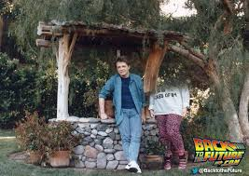
Aquinas: Third Way, Possibility and necessity.
Third way necessary being – Nothing is permanent, everything is contingent; it exists but equally well not exist, there must be a necessary being, which all the contingent beings came from, that is God.
Without the existence of the parent, the child cannot come into existence

Slide 8
Creator God?
How convincing are these arguments?

Slide 9
The Kalam cosmological argument – origins Islamic Scholars but championed Craig (1993)
Everything begins to exist has a cause of its existence
The Universe began to exist
The Universe has a cause of existence
Since no scientific explanation about the origin of universe , the cause must be personal .

Slide 10
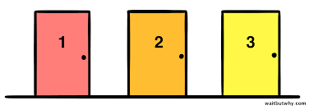
To answer challenges to the Kalam cosmological argument. Craig developed the defence
An actual infinite cannot exist
(Craig offers the following illustration. Imagine a hotel in which there actually are infinitely many rooms. Each room is filled. Now a new guest arrives and asks for a room. The hotel proprietor then "makes room" for the new guest in room number #1 by simply moving the guest in room #1 to room #2, the guest in room #2 to room #3, and so on, ad infinitum. Surely this is absurd? But where did we go wrong? We went wrong, Craig thinks, when we supposed that there could - even in principle - be a hotel that actually has infinitely many rooms.
Now suppose that the universe has no beginning. Then it seems that the past must consist in a series of events that is actually, and not merely potentially, infinite. But this is absurd for the same reason that a library with infinitely many books, or a hotel with infinitely many rooms, is absurd. So the universe must have a beginning.)

Slide 11
A beginning less temporal series of events in actual infinite. Craig thinks that the idea of an actually infinite series of past events would still be absurd.
His argument goes like this:
The temporal series of past events is a collection formed by successive addition.
A collection formed by successive addition cannot be actually infinite.
Therefore, the temporal series of past events cannot be actually infinite.
Therefore a beginning less temporal series of events cannot exist.
Can Craigs’s Kalam argument confusing?

Slide 12
Applying the argument
Apply the Cosmological Argument to the photograph and answer the questions

Slide 13
Rank the Philosopher
Click on a Philosopher to read their views and then rank them according to how convincing you think they are.

Slide 14
For and against
Read the statements and then decide whether they are for or against the cosmological argument by dragging them to a side of the scale.

Slide 15
Hume and Kant criticism’s
Hume maintained that we have no experience of universes being made and it is simply not possible to argue from causes within the universe to causes of the universe as a whole. There is a logical jump which the argument fails to recognise. It is one thing to talk about causes that operate within the system of the universe, but it is an entirely different matter to speculate about whether the system as a whole is caused.
Immanuel Kant rejected the argument outright not only because he maintained that the idea of a ‘Necessary Being’ was incoherent but also because our knowledge is limited to the phenomenal world of space and time and it is not possible to speculate about what may or may not exist independently of space and time.
Hume argued that it was illegitimate to move from saying that every event in the universe has a cause to the claim that the universe has a cause. Bertrand Russell made a similar point by remarking that this was like moving saying that every human has a mother to saying therefore the human race has a mother. One cannot move from individual causes to the claim that the totality has a cause.

Slide 16
Evaluating the argument
Read the two opening paragraphs, written by students in answer to the following question: “Science has replaced the need for God as the explanation for why there is a universe.” To what extent do you agree?
Discuss their successes and failures. Which one is best? Why? Discuss your ideas before reading the commentary

Slide 17
Key terms
Match up the key terms and definitions

Slide 18
Whether inductive arguments for God’s existence are persuasive
Strengths
Probability: posteriori, experience , testable, understandable
More than one correct answer, useful if you are unsure, flexible
Inductive arguments are the basis scientific theories, Philosophy/theological reasoning mirrors the work of science = validity
Weaknesses
The very flexibility means they can have weak arguments.
Can be challenged is there is alternative evidence.
Contradictions?
Inductive arguments, they are definite and therefore not enough to support religious belief.

Slide 19
The extent to which the Kalam Cosmological argument is convincing
Craig modern and has access scientific information. Contemporary views have a starting point.
The universe has a starting point is a scientific fact which lends itself to Craig.
The cause of the universe must be a choice of a personal being, the cause cannot be explained with physical laws, convincing as it fits a theological creation story.

Slide 20
Test yourself
Name 4 philosophers/scholars connected with the cosmological arguments AND state whether each supports or challenges the argument.

