Slide 1
Tuesday, 14 May 2019
Crime and Punishment

Slide 2
What is Shari’ah law?
Islamic Law based on the Qu’ran, Hadith and Sunnah
What is Shari’ah law?
What are the concerns about Shari’ah law?

Slide 3
Christian view on evil
Know the definitions of crime and punishment
Understand concepts of good and evil intentions and actions
To explore whether crime can ever be good
Evil can be linked with the devil (Satan) who is the source of all that is considered evil, and will tempt humans to behave badly.
Crimes involving violence against people is sinful and against God.
Evil is seen as the abuse of free will.
There is no such thing as an evil person.
Humans are not perfect and make mistakes.
The Original Sin (committed by Adam and Eve) explains why humans have a tendency to do evil, even though they are not evil in themselves.
In order to be able to see and appreciate good, then evil has to exist.
So, evil is combination of internal and external factors.
Q4 Explain two Christian beliefs about evil Refer to sacred writings in your answer. (5 marks)

Slide 4
Muslim view on evil
Know the definitions of crime and punishment
Understand concepts of good and evil intentions and actions
To explore whether crime can ever be good
The Qur’an says that there is a devil who was an angel
Allah ordered the angels to bow to Adam, but Iblis refused.
Iblis was expelled from paradise, but was able to cause Adam and Eve’s expulsion from Eden.
Iblis temps and pushes humans to be wicked.
Humans fail to show self-discipline, and give in to temptations.
Evil is a mix of powerful evil being and the weakness of humans
Q4 Explain two Muslim beliefs about evil Refer to sacred writings in your answer. (5 marks)

Slide 5
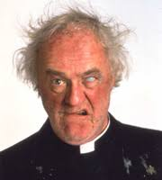
Reasons why some people commit crime
To learn key terms for this topic
To understand religious beliefs about the use and abuse of animals
To explain religious attitudes towards animal experimentation and the use of animals for food
Greed: Envy is a deadly sin
Poverty: Islam Zakat. Islamic Aid
Christianity: Tithe, Christian Aid
Hate: Islamophobia New Zealand
Upbringing: Islam Strong extended family
Mental illness: Some people with mental illness struggle to understand the world in the way others do, so they might commit a criminal act knowingly or not, while suffering from this illness
Why people commit crime?
Addiction: Islam Haram and Halal
Catholics- drunkenness is a sin
Opposition to an unjust law:‘Let everyone be subject to the governing authorities, for there is no authority except that which God has established.’

Slide 6
Secular attitudes to lawbreakers
To learn key terms for this topic
To understand religious beliefs about the use and abuse of animals
To explain religious attitudes towards animal experimentation and the use of animals for food
The law states that all suspected offenders are innocent until proven guilty. It is up to a court of law to decide if someone is guilty. If there is reasonable doubt that they did not commit the crime they are innocent and allowed to resume their normal life without punishment.
Once charged, offenders will appear in a Crown Court before a judge and a jury of 12 people, selected at random. Less serious cases are dealt in a magistrates’ court, while some more minor crimes result in the police giving the offender an official cation if they admit they are guilty.

Slide 7
To learn key terms for this topic
To understand religious beliefs about the use and abuse of animals
To explain religious attitudes towards animal experimentation and the use of animals for food
Q5 ‘There is never any reason why somebody should commit a crime’.
Evaluate this statement. In your answer, you:
Should give reasoned arguments in support of this statement
Should give reasoned arguments to support a different point of view
Should refer to religious arguments
May refer to non-religious arguments
Should reach a justified conclusion (12 marks)
Challenge that word – ‘never’ – it is absolute, so you can get a lot of arguments through it.
You have to give arguments to agree and disagree, and explain them. If you only give one side, you will have reduced marks. Don’t forget the religious argument – or again, reduced marks.

Slide 8
To learn key terms for this topic
Know the different types of crime
Analyse religious attitude to lawbreaker and different types of crime
Murder: The deliberate killing of someone.
Theft: To permanently deprive someone of something they own.
Hate crime: Any crime that is motivated by prejudice in a negative way. This could be because of race, gender, religion, sexuality or disability.

Slide 9
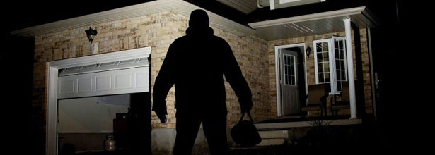
To learn key terms for this topic
Know the different types of crime
Analyse religious attitude to lawbreaker and different types of crime
What is meant by the phrase ‘crime against property’?
Crimes against property are divided into two groups: destroyed property and stolen property. When property is destroyed, it could be called arson or vandalism
Give two examples of ‘crime against property’.

Slide 10
To learn key terms for this topic
Know the different types of crime
Analyse religious attitude to lawbreaker and different types of crime
What is meant by the phrase ‘crime against the person’?
Usually refers to a crime which is committed by direct physical harm or force being applied to another person.
Give two examples of a crime against the person.

Slide 11
To learn key terms for this topic
Know the different types of crime
Analyse religious attitude to lawbreaker and different types of crime
What is meant by ‘crime against the state’?
Crimes against the state is betraying a nation by acts considered dangerous to its security
Give two examples of ‘crime against state’.

Slide 12
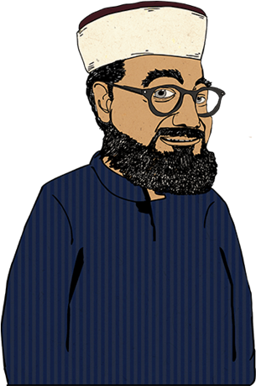
Shari’ah law: Four categories of crime HAAJ
Unforgivable crimes (Hadud): crimes such as adultery, theft, drinking alcohol or taking drugs, rebellion against the state, prohibited in Qu’ran
Forgivable crimes (Al Jynayaat) crimes against the crimes of the individual such as bodily harm and murder for which the victim or their family can gain credit by showing mercy
Community crimes (Al-Ta’azir): crimes that affect the community such as fraud and anti-social behaviour
Crimes against state law (Al Mukhalafat) crimes against a law of the state (rather than the Qu’ran) such as parking offences and speeding

Slide 13
1. What is a crime? (1 mark)
To learn key terms for this topic
Know the different types of crime
Analyse religious attitude to lawbreaker and different types of crime
a) An action of wrongdoing
b) An action which breaks the rules
c) An action a person can be punished for
d) An action which breaks the law

Slide 14
1. Which of these is NOT a type of crime in Britain? (1 mark)
To learn key terms for this topic
Know the different types of crime
Analyse religious attitude to lawbreaker and different types of crime
b) Crime against the state
a) Crime against the person
c) Crime against property
d) Crime against humanity

Slide 15
1. What are Community crimes? (1 mark)
To learn key terms for this topic
Know the different types of crime
Analyse religious attitude to lawbreaker and different types of crime
b) Al Jynayaat
a) Hadud
c) Al Mukhalafat
d) Al-Ta’azir

Slide 16
1. What is the Unforgivable crimes? (1 mark)
To learn key terms for this topic
Know the different types of crime
Analyse religious attitude to lawbreaker and different types of crime
b) Al Jynayaat
a) Hadud
c) Al Mukhalafat
d) Al-Ta’azir

Slide 17
1. What is the Forgivable crimes? (1 mark)
To learn key terms for this topic
Know the different types of crime
Analyse religious attitude to lawbreaker and different types of crime
b) Al Jynayaat
a) Hadud
c) Al Mukhalafat
d) Al-Ta’azir

Slide 18
1. What is the Crimes against state law ? (1 mark)
To learn key terms for this topic
Know the different types of crime
Analyse religious attitude to lawbreaker and different types of crime
b) Al Jynayaat
a) Hadud
c) Al Mukhalafat
d) Al-Ta’azir

Slide 19
Shari’ah law: Four categories of crime HAAJ
Unforgivable crimes (Hadud): crimes such as adultery, theft, drinking alcohol or taking drugs, rebellion against the state, prohibited in Qu’ran
Forgivable crimes (Al Jynayaat) crimes against the crimes of the individual such as bodily harm and murder for which the victim or their family can gain credit by showing mercy
Community crimes (Al-Ta’azir): crimes that affect the community such as fraud and anti-social behaviour
Crimes against state law (Al Mukhalafat) crimes against a law of the state (rather than the Qu’ran) such as parking offences and speeding

Slide 20
1. Which of these is NOT a crime against the person? (1 mark)
To learn key terms for this topic
Know the different types of crime
Analyse religious attitude to lawbreaker and different types of crime
a) Murder
b) Arson
c) Actual bodily harm
d) Grievous bodily harm

Slide 21
1. Which of these is NOT a cause of crime? (1 mark)
To learn key terms for this topic
Know the different types of crime
Analyse religious attitude to lawbreaker and different types of crime
a) Poverty
b) Upbringing
c) Addiction
d) Emotional reasons

Slide 22
1. What of these is NOT an environmental reason for crime? (1 mark)
To learn key terms for this topic
Know the different types of crime
Analyse religious attitude to lawbreaker and different types of crime
a) Where a person lives
b) Living in poverty and deprivation
c) The people they associate with
d) A person’s home background

Slide 23
1. Which of these would be considered a psychological reason for a crime? (1 mark)
To learn key terms for this topic
Know the different types of crime
Analyse religious attitude to lawbreaker and different types of crime
a) Greed, aggression and jealousy
b) To fit in with a gang and to gain a reputation
c) Addiction, money and lifestyle
d) Unpaid bills, no job and a lack of material possessions

Slide 24
1. Why is it important to know why a person actually committed their crime? (1 mark)
To learn key terms for this topic
Know the different types of crime
Analyse religious attitude to lawbreaker and different types of crime
a) To support the victim
b) As a deterrent to others
c) To provide an effective punishment and chance of reform
d) To seek retribution

Slide 25
1. If a person committed a crime to gain material possessions what would be considered the reasons? (1 mark)
To learn key terms for this topic
Know the different types of crime
Analyse religious attitude to lawbreaker and different types of crime
a) Environmental
b) Economic
c) Social
d) Mental

Slide 26
1. Which of these is a crime against a person? (1 mark)
To learn key terms for this topic
Know the different types of crime
Analyse religious attitude to lawbreaker and different types of crime
a) Arson
b) Shoplifting
c) Burglary
d) Spying

Slide 27
1. Which of these is a crime against property? (1 mark)
To learn key terms for this topic
Know the different types of crime
Analyse religious attitude to lawbreaker and different types of crime
a) vandalism
b) murder
c) rape
d) spying

Slide 28
1. Which of these is a crime against the state? (1 mark)
To learn key terms for this topic
Know the different types of crime
Analyse religious attitude to lawbreaker and different types of crime
a) Selling military secrets to a foreign power is one example
b) Fighting for your country
c) Murder
d) spying

Slide 29
STICK
To learn key terms for this topic
To know the three aims of punishment
To understand religious attitudes to the three aims of punishment
Use the definition of the aims of punishment below to complete
Retribution: To get your own back; ‘an eye for an eye’
Deterrence: To put people off committing crimes
Reformation (reform): To change someone’s behaviour for the better
Protection: To take measures to make society safe from criminals.
Vindication: The punishment exists to make the law enforceable. It exists because the law does.
Reparation: To make up for or compensate for a crime.

Slide 30
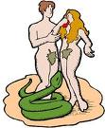
Free Will-Islam and Christianity
God created human beings with Free Will.
This means they are free to choose their actions.
If God had made humans who were always good then we would not be free in our choices.
In order to allow humans to have free will God had to take the risk of them choosing evil.
This is why there is suffering.
Some Christians believe that suffering is the result of the Fall of Adam and Eve.
They were the first people to rebel against God when they ate the forbidden fruit in the Garden of Eden that God told them they were not allowed to eat.
By doing this they brought evil and suffering in to a world that was made perfect, and they spoilt the world that God had made.

Slide 31
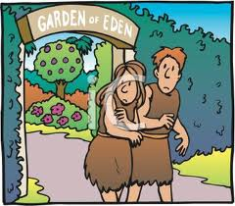
Suffering is punishment for sins Islam/Christianity
The only people who really suffer are those who have sinned.
Therefore they are only paying the price for doing wrong.
If you do bad things you deserve to suffer.
We learn from our mistakes and we grow
We can develop courage and bravery
Love only has meaning if it is freely given and we can only freely give if we have the choice not to give
Evil is useful. Without it there would be no good.
For example we need suffering in our lives to help appreciate the good times. We can learn from our mistakes. You should not even ask the question about why we suffer.
God works in mysterious ways.
Who are we as mere humans to question what God does or does not do?!

Slide 32
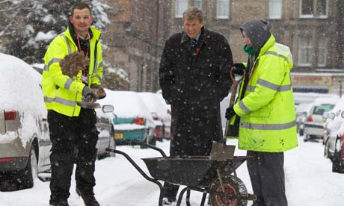
Community Service
Do you think this is effective?
What does Islam and Christianity think?
How does it support the three aims?
What are the advantages and disadvantages?

Slide 33
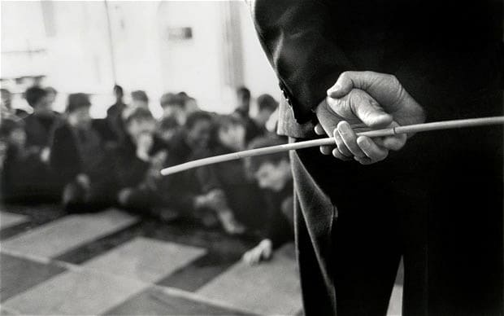
Corporal Punishment
Do you think this is effective?
What does Islam and Christianity think?
How does it support the three aims?
What are the advantages and disadvantages?

Slide 34
Corporal Punishment
Agree
Disagree
Should Corporal Punishment be brought back to UK schools?

Slide 35
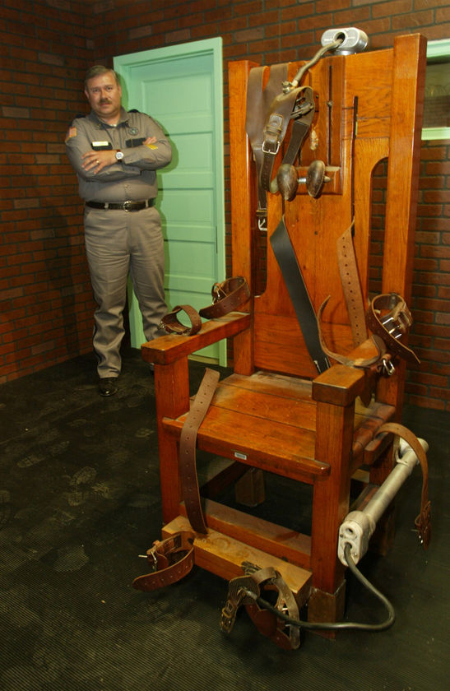
Capital Punishment
The Death Penalty was abolished in the UK in 1965 by the murder (abolition of the Death Penalty) Act 1965.
Under the European Convention on Human Rights, which Britain signed in 1999, execution was abolished throughout the European union.
Other nations, including the USA, still have the death penalty and it is estimated that there is one legal execution every day, somewhere in the world.

Slide 36
Capital Punishment- For or Against?
Principle of utility: Action is right if it promotes maximum happiness
Sanctity of Life: God gave life and has the right to take away Or those who have murdered who have taken a life forfeit their right to life
Shari’ah Law can be carried out (Murder, Treason, Apostasy, Terrorism, piracy, rape, adultery, homosexual activity) but depending victim’s family mercy/compensation, otherwise executed.
Shari’ah Law varies country as do the methods, must be sufficient evidence, death penalty generally not compulsory.
The Muslim Peace Fellowship devoted to non violence.
Old Testament: ‘Whoever sheds human blood, by humans shall their blood be’ Genesis 9:6
Life for life, eye for eye, tooth for tooth
Jesus taught forgiveness ‘ I take no pleasure in the death of the wicked, but rather that they turn away from their ways and live.

Slide 37
Retribution
To learn key terms for this topic
To know the three aims of punishment
To understand religious attitudes to the three aims of punishment
³⁸ “You have heard that it was said, ‘Eye for eye, and tooth for tooth.’³⁹ But I tell you, do not resist an evil person. If anyone slaps you on the right cheek, turn to them the other cheek also. ⁴⁰ And if anyone wants to sue you and take your shirt, hand over your coat as well. ⁴¹ If anyone forces you to go one mile, go with them two miles. ⁴² Give to the one who asks you, and do not turn away from the one who wants to borrow from you.
Matthew 5:38-42

Slide 38
Christianity and Suffering The Story of Job
What is the story of Job? | What is the message of the story of Job? | Worksheet Christian Suffering: Why is it such a challenge to the Christian faith? | If you were to ask a question to God about suffering in our modern society- what question would it be?

Slide 39
To learn key terms for this topic
Know the different types of crime
Analyse religious attitude to lawbreaker and different types of crime
Christian attitude towards lawbreakers – Sheep and the Goats video
‘Come you who are blessed by my Father; take your inheritance , the kingdom prepared for you since the creation of the world. For I was in prison and you came to visit me.
Matthew 25:34-36
This inspires Christians to treat prisoners with compassion and to consider how they may be helped as well as punished for their wrongdoings

Slide 40
Use these quotes to answer the question below
To learn key terms for this topic
To understand religious beliefs about the use and abuse of animals
To explain religious attitudes towards animal experimentation and the use of animals for food
“God created all humans equal”
Genesis
“Love your neighbour”
Mark 12:31
“There is neither Jew or Gentile, slave nor free, male nor female for you are all one in Christ Jesus”
Galatians 3:28
Golden Rule “Treat people the way you would like to be treated”
Matthew 7:12
“You shall not murder”
Exodus 20:13
4) Explain two Christian beliefs about hate crimes and murder.
Podcast

