Slide 1
Theme 3: D
The influence of religious experience on religious practice and faith

Slide 2
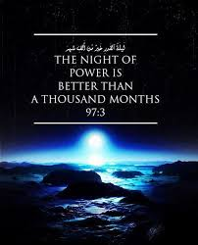
According to Hardy (examine the extent and nature of religious experiences of people in Britain today)
…. Usually induces a person concerned with conviction that the everyday world is not the whole reality; there is another dimension to life …. Awareness of its presence affects the person’s view of the world. It alters behaviour and changes attitudes’.
Religious Practice includes ritual (can be a trigger for further experience) , religious ceremonies, festivals and daily life (Duties- prayer and fasting- Ramadan, Muslims celebrate Night of Power- revelation of the Qu’ran to the Prophet Mohammed, and reflections)

Slide 3
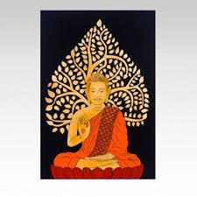
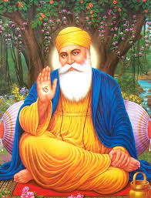
Religious Experience and Faith: ‘belief that’ statement
Aquinas viewed Christian faith as rational and explored with reason (Divine revelation was required).
A ‘belief that’ statement is I believe that in Sikhism the first Guru is Guru Nanak. It is making a claim that is objectively true and that something is a fact. Grounded in belief , historical events for example the Buddha was a wise teacher.

Slide 4
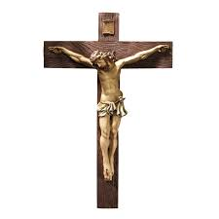
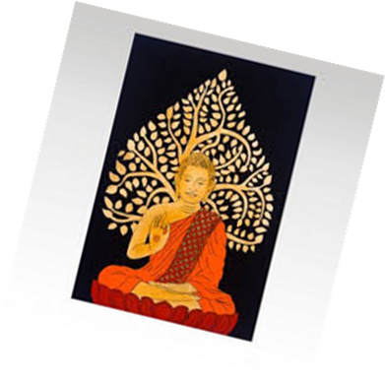
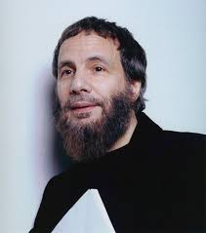
Religious Experience and Faith: ‘belief in’ statement
I believe in Jesus, means more than a historical figure, it implies trust in Jesus. Linked to the claim about salvation, resurrection. But the Buddha was wise because he taught mediation and claimed experience enlightenment (nirvana) , the belief-in the Buddha due to the faith in concept of nivarna. The belief-in is bought by personal religious experience. For example Cat Stevens read the Qu’ran and converted to Islam.
Religious experiences can include: reflection, contemplation of the divine, private prayer or meditation.

Slide 5
Religious Experience and Revelation
Revelation: Can be communicated by God (Judaism Law revealed to Moses on Mount Sinai) It involves interpreting events in a spiritual way.
Revelation is a moment of realisation coming at the end of a period of reflection. The propositional view = truths about God or ultimate reality.
The non propositional concept of revelation = understand significance of revelatory experiences , it has spiritual significance rather than political. For example the Fall of Jerusalem – act of disobedience , God was active in the world.

Slide 6
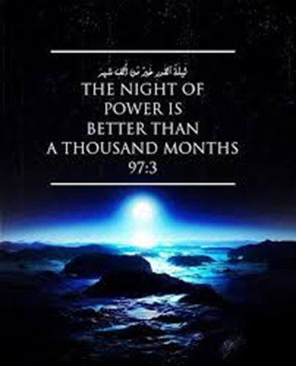
Value for religious community -affirmation
There is a pivotal figure who is linked to the founding religion. Their authority derives from religious experience. For example the angel Gabriel appeared to Muhammed in a cave. These revelations continued for 23 years, Muhammed was a passive channel to communicate God’s revelation.
The Mool Mantra , which is the start of every Chapter in the Guru Granth Sahib, he took a dip in the waters and now referred as Mool Mantra. The Mul Mantar is the first composition of Guru Nanak Dev Ji. The Guru Granth Sahib begins with the Mul Mantar and it occurs more than one hundred times throughout the text where it is placed at the beginning of the particular Shabad, or hymn

Slide 7
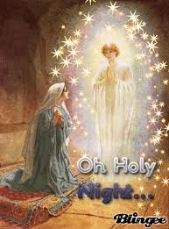
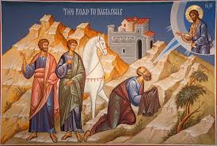
Value for religious community -affirmation
In Christianity revelation appearance of Angels to Mary and Joseph. This affirms the incarnation , the experience of the disciples of the resurrected Jesus affirms belief about life after death.
Paul changed from being someone on a mission to arrest Christians to someone preaching and suffering for proclaiming Jesus of Nazareth as the Messiah. There was a conversion on the road to Damascus as there were religious experiences that had taken place.

Slide 8
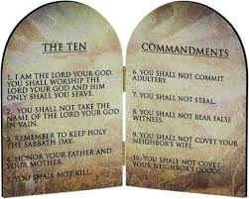
Value for religious community –promotion of faith value system
Religious Experience can be the source of ethical standards. Moses received the Ten commandments which includes customary law and ritual ordinances.
Jesus and Paul reveals ethical standards through behaviour: ‘Love the Lord your God with all your heart, with all your soul’. Jesus is the Messiah as he is the son of God and performed miracles.

Slide 9
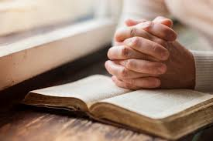
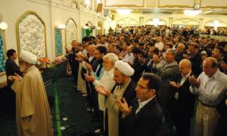
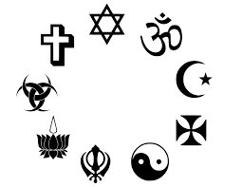
Strengthening cohesion religious community
A community might be strengthen by a religious experience. This might strengthen a community through collective worship, create a sense of unity through fellowship, establish a sense of identity, highlight a common purpose through specific events (festivals, rites of passage), reaffirming faith (reading texts hymns), expressing and sharing ones’ spirituality with others (testimonies, personal experiences)

Slide 10
The value in celebrating a past religious experience
Festivals or Pilgrimage: Wesak celebrates Buddha’s enlightenment
Ramadan reveals when the Qu’ran was revealed to the Prophet Muhammed. Eid al Adha remembers Abraham’s willingness to sacrifice his son when Allah ordered him to do so.
Judaism Pesach, remembers Passover when the Israelites were spared the ten plagues and were freed from Egypt. The Sedar meal that takes place with a family retells the story.

Slide 11
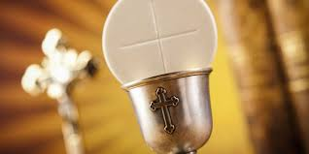
Value for the individual; - faith restoring
Religious Experience , testimony of the religious experience can be of value to the individual. If one’s own faith is struggling and doubting settling in, then having a religious experience , a meeting with God can remove doubts and renew faith, being with others, and renewing faith, participating in a ritual such as the Eucharist, pilgrimage can rekindle faith.

Slide 12
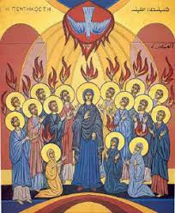
Value for the individual; - strengthening faith in face of opposition.
Faith may be strengthened in the face of opposition, may include an account of God, believer is given strength to face opposition, accounts martyrs that faced persecution (Jesus and crucifixion and Khalsa).
Prayer and meditation in the face of opposition can lead to religious experience in which the person gains strength to confront the situation. The religious experience at the Pentecost when the Holy Spirit was claimed upon the disciples, they could not stop, they had to obey God rather than human beings.

Slide 13
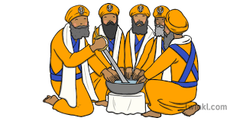
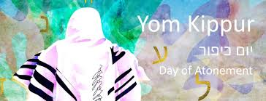
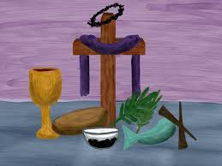
Value for the individual; - renewal of commitment to religious ideas and doctrines.
Renew commitment to faith and ideals, or to confirm their faith. Initiation into a faith. Sikhism- Amrit ceremony , hymns are recited, prayers are said, drink Amrit (Holy Water) and sprinkle on the eyes, recite the Mool Mantra.
Judaism Rosh Hashanah (New Year) marks the 10 day period of atonement leading to Yom Kippur (atone their sins).
Christianity Lent – similar activity where reflection and renewal during the time of Lent. Christians observe a period of fasting and self-denial.

Slide 14
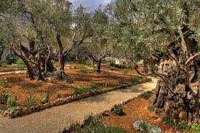
AO2 : The extent to which religious experiences impact upon religious beliefs and practice.
It is difficult to separate religious experience from religious belief and practice, but is it a one way experience? Individuals hear God’s voice, meditation, state of tranquillity, seek union with God, Yoga.
Individual’s prayer is important but not in comparison to Jesus in Garden Gethsemane, Paul and healing on the way to Damascus. How about Eucharist and Transubstantiation of the Roman Catholics?
By participating rituals such as Lord’s prayer or the Mool Mantra . The Creed recited , formulated key religious experiences , both individuals/communities demonstrate what is important to them, restating their beliefs allow both individuals and communities to demonstrate what is important to them

Slide 15
AO2 : The extent to which religious experiences impact upon religious beliefs and practice.
Religious Pilgrimage or Festival such as Ramadan , verses revealed to the prophet Muhammed, Wesak celebrates the Buddha and his teachings.
Some dispute the truth behind these religious experiences , some scholars dispute the literal interpretation of the virgin birth and physical resurrection of Jesus, they see them as mythological.
Religious experiences are not necessary for belief and practice but gathering at a church is strengthening community cohesion( preserves identity and reinforces common bonds)
Joining a religion might involve initiation ceremony for example the Amrit.
Are conversion just inner battles? Are changes in behaviour due to religion or psychology?

Slide 16
AO2 : Whether religious communities are entirely dependent on religious experiences
Foundation of faith is dependent of religious experience and their founders. Judaism the Covenant, Moses and burning bush, Christianity- Jesus resurrection, miracles and baptism.
Based on religious experience through festivals and pilgrimage, Pesach- Passover when the Israelites were freed, reaffirms traditions like the Sedar meal.
However religious experiences have been challenged, interpreted as symbolic or mythological but still inspire and is meaningful.
Individual worship like prayer is central to worship such as Jummah Friday prayers. Strengthens religious community. The giving testimony is important as it adds validity belief and practice, important part of Baptism, shares spirituality.

Slide 17
AO2 : Whether religious communities are entirely dependent on religious experiences
Religious experiences especially mystic ones are exclusive to a few, if only a few see them then are they less spiritual?
Those who have gone through religious experience have achieved a higher status?
Religious experience, is God of a past? Religious experiences are part of religious communities, prayers are an integral part of religious experiences how about mystic experiences?
Religious experiences is essential for the believer as you experience them directly not on second hand accounts.
Doubts: physiological – drugs
Swinburne: defended validity on principle credulity
Reliability of the founder?

Slide 18
AO2 : Whether religious communities are entirely dependent on religious experiences
Most religions there is a pivotal figure, they usually experience an event, their experience is a confirmation of their message. However there are doubts to the reliability of ancient sacred texts, interpreted as symbolic or mythological rather than historical/literal.
David Hume, religions accounts vary and contradict each other, if we confirm one belief how about other beliefs?
If we already believe in God and the supernatural , Religious experiences cannot be used to show that God exists.

