Slide 1
T4 Religious Language- Read Chapter
B: Religious language as cognitive but meaningless

Slide 2
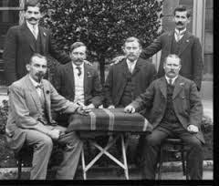
Logical Positivism
Grew from Vienna Circle (Philosophers – Wittgenstein): philosophical, all knowledge reduced to scientific/logical formulations.
Anything outside logical/scientific tenets is dismissed as meaningless.
Tautological (self-explanatory) could be verified by observations/first person experience.

Slide 3
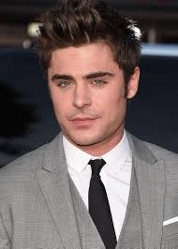
Verification
To verify something to show something is true, to authenticate it. According to Logical Positivism , the only two forms of knowledge were logical reasoning and statements that were open to empirical evidence.
Tautological statements (self explanatory) "It will snow tomorrow, or it will not snow tomorrow" is an example
Mathematical Statements
Synthetic statements (statement backed by sense experience) "There are owls in Austria"
Analytic statements (statement is determined within statement itself – All bachelors are unmarried"

Slide 4
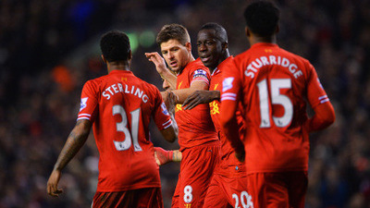
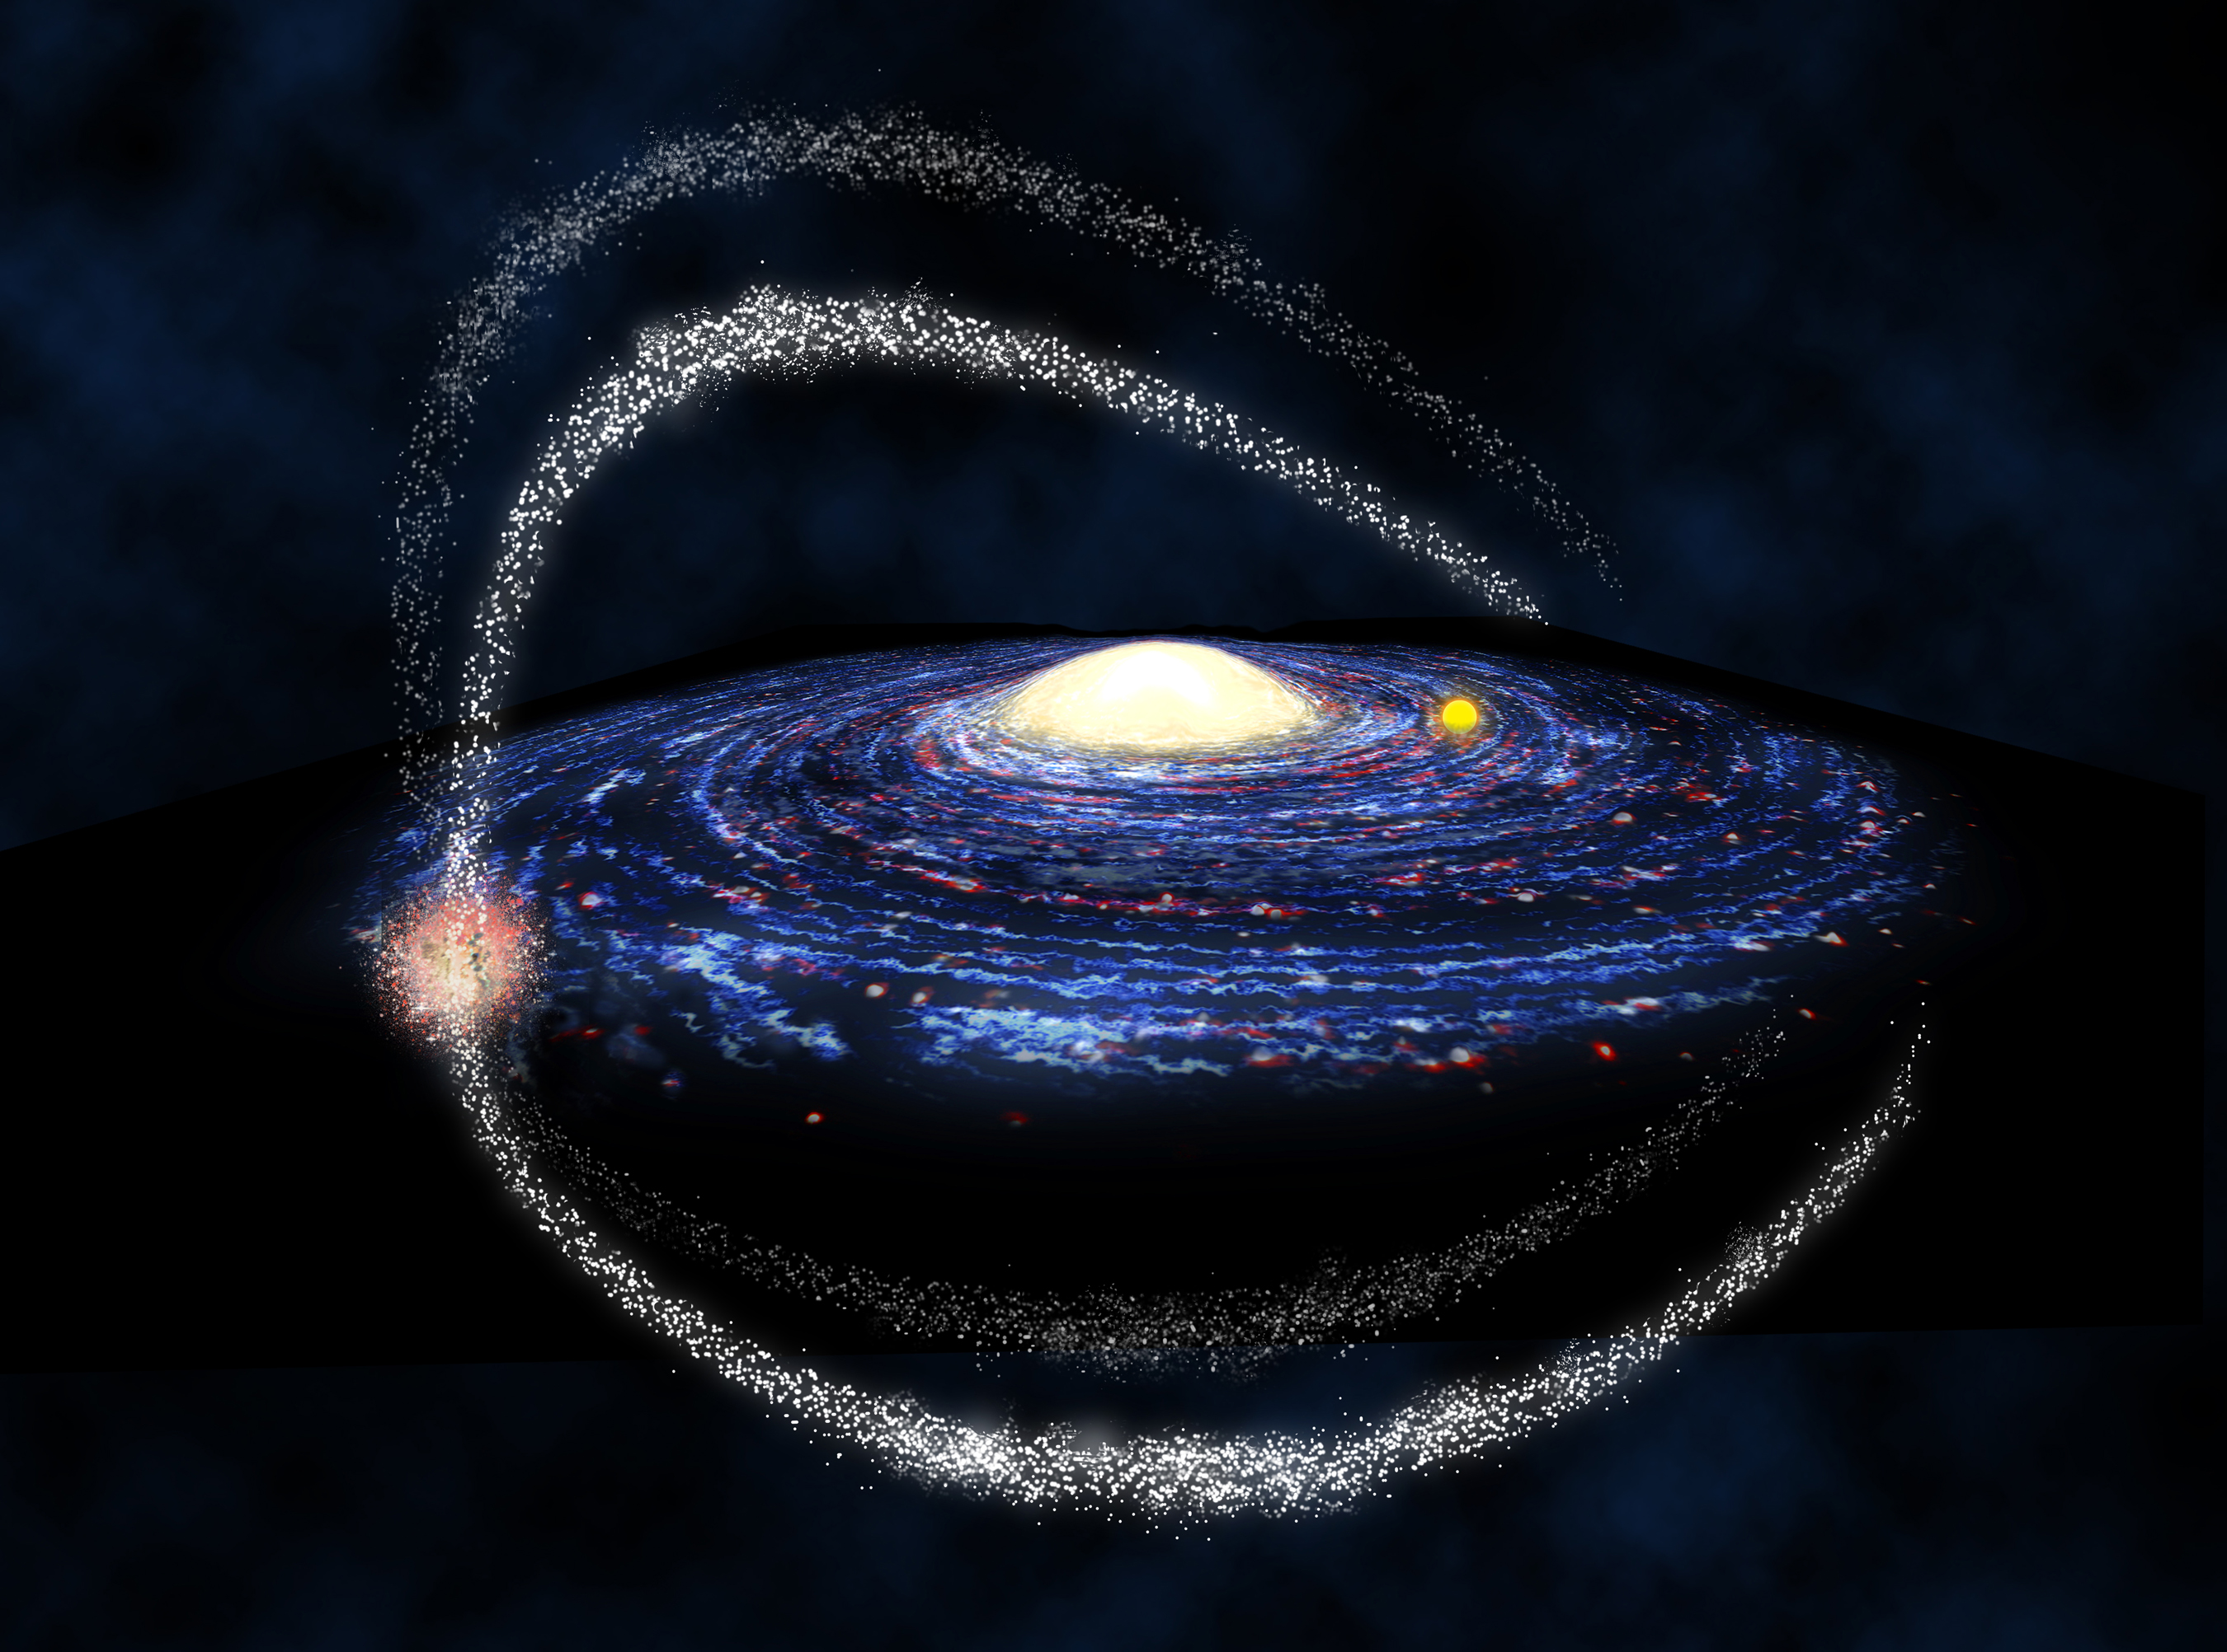
Verifiability…
Maths (a priori) | Tautology (analytic – a priori) | Practical Verifiability (synthetic) | Verifiability in Principle (synthetic)
Pure logic e.g. 2+2=4 | A logical statement which we can know to be true by definition. e.g. ‘Bachelors are male’ This is verifiable as it would be illogical to think the opposite. | Statements which could be tested in reality. e.g. ‘Liverpool Football Club wear red shirts.’ This is verifiable in practice – we can go and watch a match. | Statements which we cannot verify in practice, but know what observations would lead it to be true. They can be shown to be probable by observation and experience. e.g. ‘There is life on other planets in the Milky Way Galaxy’ or ‘All humans are mortal’ In practice we do not have the technology to visit all the planets in the Milky Way. Nor can we kill all the humans in the world.
+
=

Slide 5
Match the Keyword to the Definition to the example
Mathematical Statements | A statement backed by sense experience | "There are owls in Austria"
Synthetic statements | (self explanatory) | All bachelors are unmarried"
Analytic statements | A sentence which is either true or false. It may contain words and symbols. | "It will snow tomorrow, or it will not snow tomorrow"
Tautological statements | A statement is determined within statement itself – | 1 + 1 = 2

Slide 6
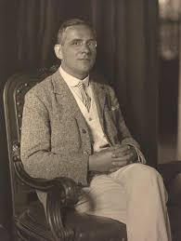
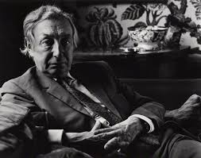
Verification – Vienna Circle
Schlick ‘Verification Principle’, statement is true or false.
AJ Ayer : a synthetic statement is meaningful if and only if it has some relation to observation. Ayer attacked metaphysics regarding it as meaningless, nothing more than a misunderstanding of how reality should be described. Verification has a limitation, for example we cant verify Lord Nelson won battle Trafalgar, we were not there but its was likely it had happened.

Slide 7
Verification – Vienna Circle
Ayer: In practice, statements whose truth or falsehood could be determined by some observation or experiment that could be carried out in the present day. In contrast, the criteria of in principle allowed verifiability but only in theory.
‘there are mountains on the furthest side of the Moon, no rocket has been invented which would enable me to look, I cannot make an observation, but I do know what observation would decide for me, if theoretically conceivable , the proposition is verifiable in principle, for one cannot conceive of an observation’.

Slide 8
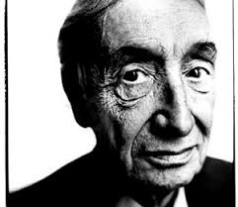
Verification – Vienna Circle
But this still does not support statements just as ‘I talked to God’.
Weak Verification: Sense experiences merely count towards establishing truth value, truth cannot be established with certainty by any finite series of observations
Strong Verification: If the verification is conclusive then Ayer said that it was strong verification.

Slide 9
Criticisms of verification: Hick eschatological principle– Parable journey Celestial city
The meaning of a statement is its method of verification, is neither logical or obvious nor is it supported by empirical evidence, the statement is nor verifiable. The parable points to the possibility of eschatological verification, whereby in the next life our belief will be proved true or false (verified).
“Two men are travelling together along a road. One of them believes that it leads to the Celestial City, the other that it leads nowhere. But since this is the only road there is, both must travel it. Neither has been this way before, therefore neither is able to say what they will find around each corner. During their journey they meet with moments of refreshment and delight, and with moments of hardship and danger. All the time one of them thinks of his journey as a pilgrimage to the Celestial City … The other, however, believes none of this, and sees their journey as an unavoidable and aimless ramble … Yet, when they turn the last corner, it will be apparent that one of them has been right all the time and the other wrong…”

Slide 10
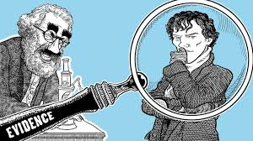
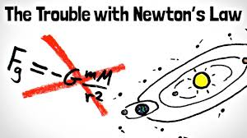
Falsification: Karl Popper
For something to be meaningful there has to be evidence which could count against the statement (to empirically refute it). If a principle is scientific then it should be disprovable. For example look at theories to disprove gravity , we test with evidence. Theories are considered true until some evidence shows them false. If the statement is considered to be false then the statement was meaningful, if no observation could ever count against a statement then the statement was considered meaningless, if the statement asserts nothing, then it cannot mean anything.

Slide 11
Falsification: Karl Popper
Antony Flew- Parable of the Gardener, religious statements cannot be falsified and were therefore meaningless. Why would you allow evil against a loving God, these beliefs are not falsifiable and died a thousand qualifications.
“Once upon a time two explorers came upon a clearing in the jungle. In the clearing were growing many flowers and many weeds. One explorer says, ‘some gardener must tend this plot.’ The other disagrees, ‘There is no gardener.’ So they pitch their tents and set a watch. No gardener is ever seen.”

Slide 12
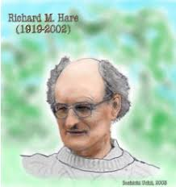
Criticisms of Falsification: Richard Hare, differences between bliks about the world cannot be settled by observation of what happens in the world
The concept of meaningfulness came from the impact of belief had on individual, not empirical verifiable or falsifiable nature of belief. Bliks (look at our lives and experience), blik can affect our behaviour even if it cannot be falsified.
Parable of the Paranoid Lunatic: A certain lunatic is convinced that all dons want to murder him. His friends introduce him to all the mildest and most respectable dons that they can find, and after each of them has retired, they say, “You see, he doesn’t really want to murder you; he spoke to you in a most cordial manner; surely you are convinced now?” But the lunatic replies, “Yes, but that was only his diabolical cunning; he’s really plotting against me the whole time, like the rest of them; I know it, I tell you.” However many kindly dons are produced, the reaction is still the same

Slide 13
Criticisms of Falsification : Basil Mitchell
Mitchell commented on Flew he had misunderstood religious believers perspective when he had stated that religious believers allow nothing to count against their belief. Mitchell stated religious believers face challenges to their beliefs, a trial of faith , the evidence against the beliefs was not discounted and believers did not loose meaningful through death of thousand qualifications, religious language as being meaningful.
Basil Mitchell offers the Parable of the Partisan to illustrate the concept of non-propositional faith – a trust in God which may be held even when evidence or experience points to the contrary:
During the time of a war a Partisan meets a stranger claiming to be the leader of the resistance. The stranger urges the Partisan to have faith in him, even if he is seen to be acting against Partisan interests. The Partisan is committed to a belief in the stranger’s integrity, but his friends think he is a fool to do so. The original encounter with the stranger gives the Partisan sufficient confidence to hold onto his faith in him even when there is evidence to the contrary.

Slide 14
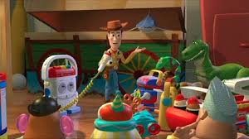
Criticisms of Falsification : Richard Swinburne
Plenty instances language is meaningful by people, even without empirical evidence to support it. We may not be able to disprove but that does not mean it did not happen .
Richard Swinburne argues that there are many unfalsifiable statements like religious claims that have meaning. For example, the toys in a cupboard which to all appearances stay in the cupboard until no-one is watching and come out and dance in the middle of the night leaving no sign or trace of their activities.

Slide 15
AO2: The persuasiveness of arguments asserting either the meaningfulness/meaninglessness of religious language.
Language such as soul , God are not identifiable , so are meaningless.
The lack of verifiable evidence such a statement is meaningless, no relation to the reality to the world or senses.
A form of language that is objectively experienced , considered as meaningful. Logical Positivists – language can be reduced set of observable criteria , Tautological statements can be seen as meaningful, so the criteria of verification principle is meaningful.
Braithwaite – Non-Cognitive – missed the point Religious Language, Religious language meaningful because it affects the way they live their life. Blik – the way they see the world

Slide 16
AO2: How far logical positivism should be accepted as providing a valid criterion for meaning in the use of language
Vienna Circle required for all language to be subject to scientific enquiry. Analytic language is self-explanatory and a priori as is tautological and mathematical.
Synthetics is sense based and fits with scientific community, Religious Language did not fit.
Ayer (logical positivists) points out that its not always possible to verify all statements , this is the weak verification principle. For example the mountains on the moon, we can verify in principle.
John Hick eschatological verification, truth God’s existence would be known after death

