Slide 1
EDUQAS A LEVEL

Slide 2
Component 1 the Study of Religion (Christianity)
Religious Figures and Sacred Texts
Jesus- his birth
Jesus- his resurrection
The Bible as a source of wisdom and authority in daily life
The Bible as a source of wisdom and authority
The early church
Two view of Jesus
Religious Concepts and Religious Life
The nature of God (Is God male? Can God suffer?)
The Trinity
The atonement
Faith & Works
The community of believers
Key Moral Principles

Slide 3
Component 1 the Study of Religion (Christianity)
Significant Social and Historical Developments in Religious Thought
Attitudes towards Wealth
Migration and Christianity in the UK
Feminist Theology & the Changing Role of Men & Women
Challenges from Secularisation
Challenges from Science
Challenges from Pluralism and Diversity within Tradition
Religious Practices that Shape Religious Identity
Baptism
Eucharist
Christmas & Easter
Unification
Religious Experience
Poverty & Injustice

Slide 4
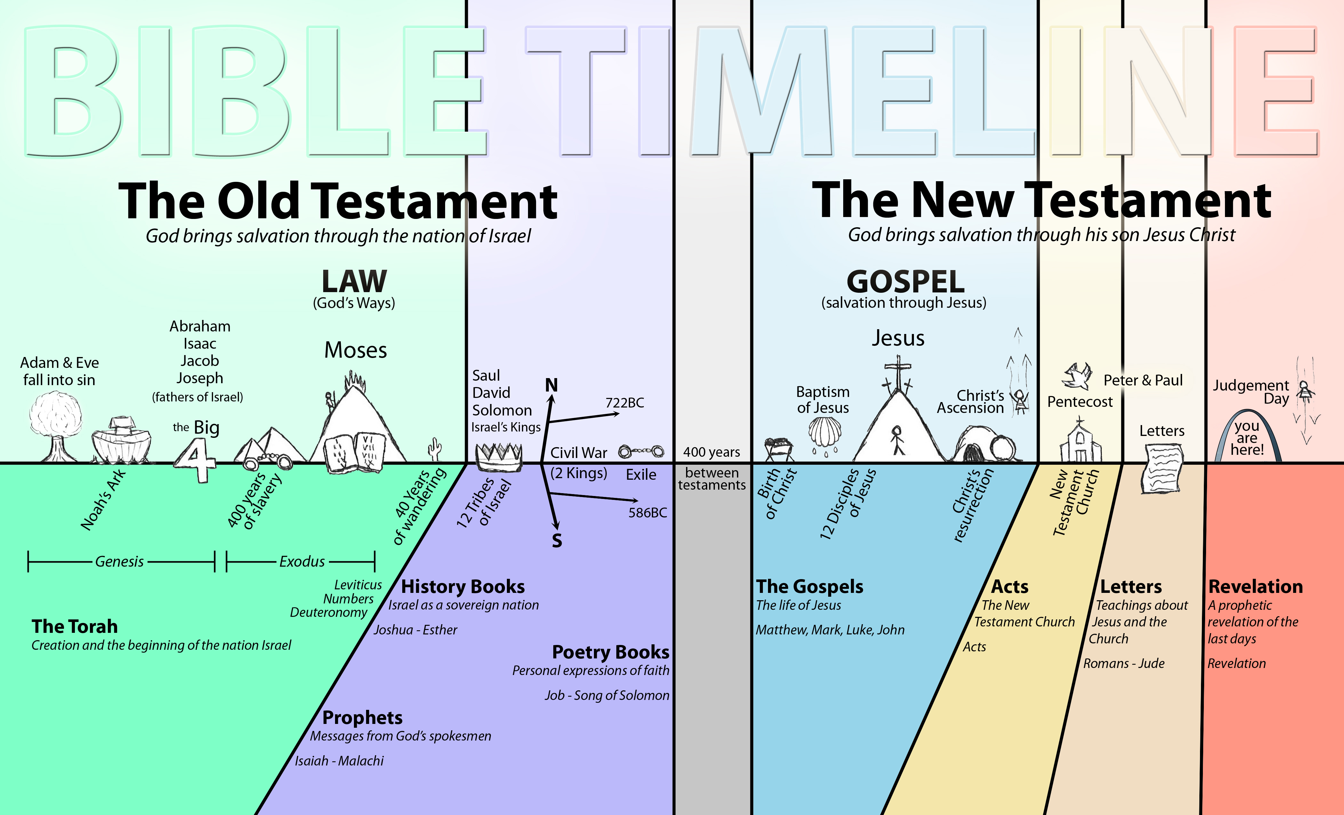
http://messiahnetwork.org/wp-content/uploads/2014/09/BIBLE-TIMELINE-NEW.jpg

Slide 5
Theme 1A Jesus Birth
1A
https://www.youtube.com/watch?v=6k-C3Kse17I
What do we know about The Bible?
What do we know about the birth of Jesus?
Why is the event important?
You have two narratives of Jesus birth.
Read through them. Highlight or underline any words you don’t know.
What are the similarities?
What are the differences?
Why are they different?

Slide 6
Theme 1A Jesus Birth
1A
The Gospel of Matthew
1st of the synoptic gospels
Composed between 80-90AD
Probably a Jewish male
Familiar with legal aspects of scripture being debated
Written in Semitic “synagogue Greek”
Sources include the Gospel of Mark, Q source and M source

Slide 7
Theme 1A Jesus Birth
1A
The Gospel of Luke
3rd of the canonical gospels
Although grouped with Matthew and Mark, it has a lot of similarities to John
The same author wrote the book of Acts
Sources include the Gospel of Mark, Q source and L source
Author describes the book as a narrative, rather than a Gospel
Author assumes an educated Greek-speaking audience

Slide 8
Key Words
1A
Incarnation: en carne meaning ‘in flesh.’ most commonly used to refer to the belief that Jesus was God in human form.
Credibility: the extent to which something is believable or can be trusted.
Redaction: the process of editing text for publication
Harmonisation: an attempt to compile the canonical gospels into a single account
Substantial presence: the whole and entire presence of both the divine and human aspects of Jesus Christ
Kenotic model: belief that Jesus voluntarily emptied himself of his own will in order to receive entirely the divine will

Slide 9
Differences between Matthew and Luke
Detail | Matthew / Luke
Angels | An unnamed angel appears to Joseph Angel Gabriel appears to Mary
Mary and Joseph | Joseph marries Mary (1:24) Joseph is engaged to Mary (1:27, 2:5) Mary visits Elizabeth Mary’s song- the Magnificat The birth of John the Baptist Zechariahs prophecy- the Benedictus The census
Visitors | The wise men The shepherds
Herod | The slaughter of infants
Temple | The presentation of Jesus in the Temple. Simeon’s song- the Nunc Dimittas
Return journey | The flight to Egypt The return to Nazareth from Egypt The return to Nazareth from Jerusalem
Chronology | Jesus was born at the time of King Herod More specific: when Quirinius was governor of Syria.

Slide 10
The Historicity of the Accounts
Matthew gives little historical detail.
He does refer to the massacre of baby boys under King Herod.
No evidence of this in any other accounts.
Author trying to make parallels to Moses in the Old Testament?
Luke’s chronology appears to be inaccurate.
It can’t be established that he was governor in the days of Herod (6-12CE)
No evidence of the first enrolment census happening until 6-7CE, not years earlier as Luke suggests.
Misled readers with regard to the three hymns- already being used in early Christian communities before Luke attributed them to these characters.

Slide 11
The Historicity of the Accounts
Many people doubt the historicity of both accounts because of what the events that accompany Jesus’ birth:
Angel appearing to Joseph to announce Mary is pregnant by Holy Spirit in Matthew, as well as appearing to the Magi.
Angel appearing to Mary.
When Mary visits Elizabeth, Luke claims that Elizabeth’s unborn baby leaps in her womb as he recognises the unborn Jesus.
A choir of angels appearing to the shepherds.
Simeon recognising the baby as the Messiah in the temple.
Amazingly though, both claim that Jesus was conceived by Holy Spirit and born of a virgin.
He was human in nature because of Mary and divine in nature of being conceived by God. His birth is a miracle.

Slide 12
Harmonising the accounts
Because the accounts are so different, there are many that doubt their accuracy.
However, because the accounts don’t actually contradict each other, there’s no reason that both accounts cant’ be accurate and therefore true.
Both may have had access to information that the other one did not have access to.
Some believe that Luke’s account came direct from Mary herself, which would explain a lot of what is included in his account.
There’s no reason why they didn’t flee to Egypt after he’d been presented in the temple.
There is no reason why he couldn’t have been visited by both the Magi and the shepherds.

Slide 14
Harmonising the accounts
There are some clear similarities:
Born in Bethlehem, at the time of Herod
Visited by people shortly after his birth
Born of Mary, who was a virgin and betrothed to Joseph
That he was conceived by Holy Spirit
That he was the fulfilment of Hebrew Bible prophecies and that he came to save humankind.

Slide 15
The theory that NT writers adapted existing material about Jesus to suit their own agenda
The Redaction Criticism
Many scholars believe that the authors not only collected existing material about Jesus, but adapted it to suit their own purposes, to address a particular situation or reach a certain audience.
This is known as the redaction criticism.
Redaction criticism began in Germany in the 1940s.
It argues that the original traditions about Jesus circulated as independent units in the early church and each writer chose the material he wanted to suit his own theological interests.
Possibly therefore making significant additions and omissions.

Slide 16
The Redaction Criticism
Matthew is argued to be aimed at Jewish readers.
He is committed to prove the point that Jesus was connected, through Joseph with King David and therefore is the fulfilment of the Hebrew Bible prophecies.
Quotes from the Hebrew Bible at least 4 times in his birth account
Believes that Jesus didn’t come to only save the Jews- therefore the first visitors were “from the east.”
The theory that NT writers adapted existing material about Jesus to suit their own agenda

Slide 17
Luke is also convinced by Jesus universal importance.
Luke is probably Paul’s friend and the only non-Jewish writer of the NT
The book appears to be aimed at the Gentiles. Both books are dedicated to Theophilus- a Greek name.
Luke’s account is distinctly Greek. He refers a lot less to the Hebrew Bible, and when he does, he quotes from the Greek version.
Writing from Mary’s viewpoint shows less emphasis with the line of David and more emphasis with the marginalised (as women were at the time).
His first visitors in this account were poor shepherds- emphasising that Jesus came to save the poor and needy as well.
Luke does still emphasise a connection between Jesus and the Jewish people.
The Redaction Criticism
The theory that NT writers adapted existing material about Jesus to suit their own agenda

Slide 18
https://www.youtube.com/watch?v=I6XMn-yH71E
Incarnation
The doctrine of incarnation expresses the belief that Jesus was God in human form.
His birth was therefore not the beginning of his story, and his death was not the end.
But they also assert that while Jesus was fully God, he was also fully human.
Hypostatic union: the natures were united in Jesus Christ.
He is not half man- half God.
How could an omniscient God be a baby?
How could Jesus, if he was God, be tempted? Or not know when the world was going to end?
En carne: becoming flesh

Slide 19
https://www.youtube.com/watch?v=5kN6D6RFqLA
Kenosis
Kenosis tries to answer some of these questions.
Philippians 2:7, Paul says, ”though he was the in the form of God, did not regard equality with God as something to be exploited, but emptied himself, taking the form of a slave, being born in human likeness.”
What does Paul mean by this?
It cannot mean that Jesus emptied himself of his divinity and stopped being God, because he continued to be God during his earthly ministry, although his divine attributes were hidden.
(Substantial presence: the whole and entire presence of both the divine and human aspects of Jesus Christ)
Greek word keno- means to empty

Slide 20
https://www.youtube.com/watch?v=5kN6D6RFqLA
Kenosis tries to answer some of these questions.
Philippians 2:7, Paul says, ”though he was the in the form of God, did not regard equality with God as something to be exploited, but emptied himself, taking the form of a slave, being born in human likeness.”
What does Paul mean by this?
It cannot mean that Jesus emptied himself of his divinity and stopped being God, because he continued to be God during his earthly ministry, although his divine attributes were hidden.
(Substantial presence: the whole and entire presence of both the divine and human aspects of Jesus Christ- link to Eucharist)
it points to the pre-incarnate self-limitation of Jesus in being born of a human being, therefore accepting the limitations of being human.
Kenosis
Greek word keno- means to empty

Slide 21
Examine the differences between Matthew and Luke’s accounts of Jesus Birth. (AO1)
Matthew focusses on…
Luke focusses on...
There are several examples of differences in their accounts. They include...
Luke’s chronology is particularly suspect because…
It is not, however, impossible to harmonise the accounts by suggesting…
Redaction critics argue that the differences in the accounts may be attributed to…
In conclusion…
Developing Skills: A01
Knowledge and understanding

Slide 22
To claim that Jesus was both God and man makes no sense at all.
The issue for debate here is the reasonableness or otherwise of the doctrine of the incarnation, which asserts that…
The contention would be accepted by Jews and Muslims, and some Christian denominations such as Unitarians, on the grounds that…
It would however be rejected by most mainstream Christians on the grounds that…
It is my view that…and I base this argument on the following reasons:
Developing Skills: A02
Evaluation and analysis

Slide 23
Resources
1A
Bible Timeline
Birth Narratives
Timeline of Gospels
Gospel Comparison
McGrath Reading

