Slide 1
Theme 4: Religious Experience A

Slide 2
A: The nature of religious Experience
A vision is the ability to see something beyond normal experiences i.e. a supernatural or prophetic sight.
A vision which has a sensory characteristic is with sense characteristic, where external objects, sounds or figures appear before the recipient. A vision can have intellectual quality if the vision brings the recipient inspiration.
Dreams can involve visions, unconscious state where knowledge and understanding is gained through images or a dream narrative.

Slide 3
The nature of religious experience with particular reference to conversion- individual , communal, sudden, gradual
Conversion : To change direction. There can be communal conversions such as the Disciples gathered in a room and received the Holy Spirit.
Sudden or gradual
Conversion William James
Conversion passive/active, conversion comes without seeking it or seeks a spiritual meeting /evangelistic meeting.
Give up personal will either freely (volitional) or an internal battle- self-surrendering
Creates a new person

Slide 4
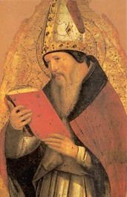
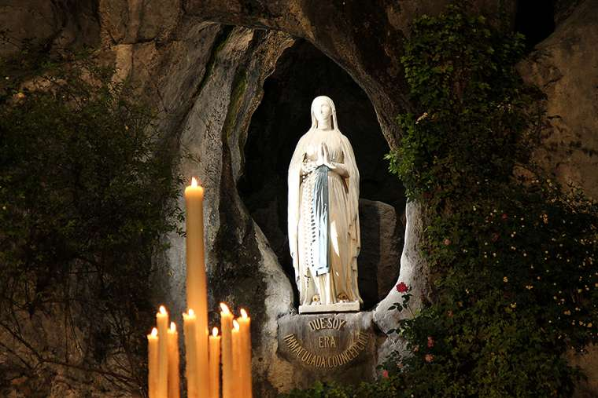
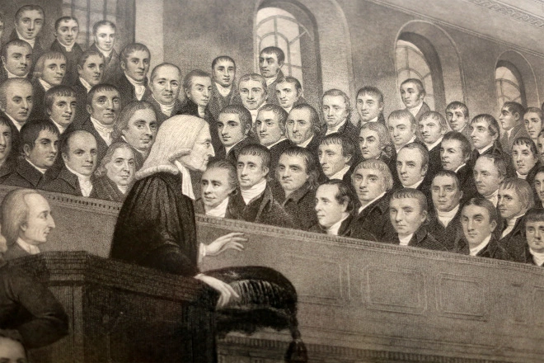
Different descriptions/explanations of a conversion
A conversion from no faith to faith – Augustine
One faith to another Sundar Singh: dissatisfied Sikhism had a vision of Jesus and was Christian.
Intellectual Persuasion:
Conflict two systems and the new one is seen as true, change moral lifestyle
William James- Conversions
Intellectual conversion: CS Lewis talked with JRR Tolkein after hours and became convinced Jesus was the Son of God.
Faith- believing to faith trusting: Wesley was aware did not have faith in Christ but warmed to Christianity later.

Slide 5
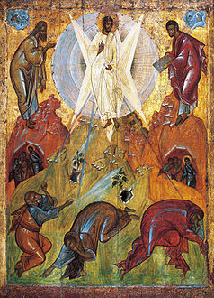
The nature of religious experience with particular reference to Mysticism –transcendent, ecstatic and unitive : Ed Miller 1995
Transcendent: Not localisable in space or time
Ineffable: not expressible in language
Noetic: Convey illumination/truth
Ecstatic: filling the soul with bliss
Unitive: Uniting the soul with reality

Slide 6
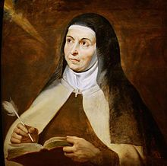
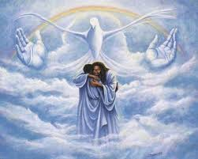
Nature Religious Experience
Mystical Ascent: Ladder/staircase, can ascent to gain unity with the ultimate reality, metaphoric journey from darkness to light.
Transcendent mysticism: Mystical experiences that take the practitioner beyond the realm of the normal everyday experience. Can involve experiences ecstasy and unitive experience. For example Sufism.
Mystical ecstatic is well documented, Teresa Avila regards ecstasy as the suspension of the exterior senses. One relates to interior sensation where the mind becomes focussed, physical sensation – individual trance like state.
Unitive mystical experience covers a range of experiences , union between God and individual.

Slide 7
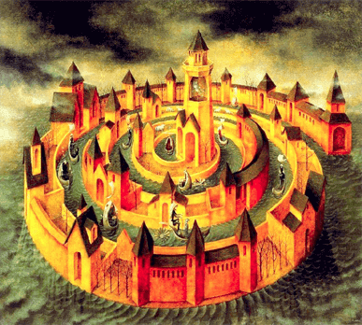
The nature of religious experience with particular reference to prayer- types and stages of prayer according to St Teresa Avila
After severe illness Teresa partially paralysed for three years she became disillusioned with her religious practices. A vision of sorely wounded Christ inspired St Teresa’s spiritual journey. It is not possible for an individual to achieve that union by themselves but through God’s grace: Four stages of prayer.
Interior Castle: The Soul is like a castle that contains seven mansions, first three mansions begin to be closer to God, the latter mansions have a deep union with God.

Slide 8
A02: The impact of religious experiences upon religious belief and practice
How would you know that it is God that you are experiencing?
Same experience? Initiates God’s existence, a change of behaviour in the new convert.
How do you assess the impact of a religious experience/conversion? (Belief in God or a change in behaviour- Augustine)
Swinburne: Credulity and Testimony (direct experiences)
William James: religious experiences changes the lives individuals, acceptance to base their belief in God upon the acceptance of another religious experience.

Slide 9
Whether different types of religious experience can be accepted as equally valid in communicating religious teachings and beliefs
Lack of uniformity religious experience, there are such a wide range the accounts are diverse and are contradictory, can be relative or dependent on spiritual experience and cultural beliefs.
Ineffability: beyond verbal description, its subjective and private. How can they be valid?
Some religious experiences are superior to others , they may communicate a particular faith potentially making others feel inferior.
Varying accounts allows then to have a pluralistic outlook.

Slide 10
All religious experiences have the same value for communicating or evidencing religious belief and specific teachings but it depends upon the type of experience.

Slide 11
All religious experiences have the same value for communicating or evidencing religious belief and specific teachings

Slide 12
Religious experiences are not intended to have the same value for communicating or evidencing religious belief and specific teachings.

Slide 13
Some religious experiences are better at communicating or evidencing religious belief and specific teachings.

Slide 14
Not all religious experiences can communicate or evidence religious belief and specific teachings.

