Slide 1
T3:
A: The problem of evil and suffering

Slide 2
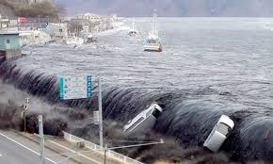
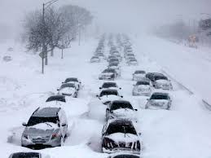
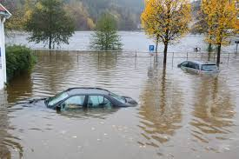
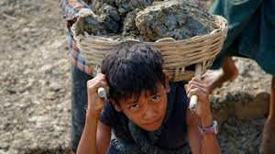
Evil: Moral (caused by free-will- individual that could have chosen to do good – So God can’t be held accountable) and Natural (caused by nature, outside control free will agents – but free-will agents might set in motion like climate change) – Which is which?

Slide 3
The logical problem of evil: classical (Epicurus) – The problem of suffering
If a belief system suggests that the universe was created deliberately out of nothing by a God that is all powerful , all-knowing and all-loving then how is it possible that things in the universe can go wrong. This is the constant challenge.

Slide 4
John L. Mackie modern development – the nature of the problem of evil (inconsistent triad)
Mackie points out that its logically inconsistent for three statements to exist simultaneously, If God is powerful why is there evil?, If he were benevolent then he would love his creation and remove evil and so on.
If we removed a characteristic such as omnipotence then we might understand why evil exists, Whitehead : God responsible to start the evolutionary process but did not have power to remove evil.
If we Removed Omni-benevolence? If he is not all loving then who cares if one suffers? Such a God would be far removed from Classic theistic God
If we remove that evil exists, there is no contradictions, if we see from God’s eye then suffering has a purpose that we do not understand as its from God’s perspective
God is omnipotent
God is omnibenevolent
God is Evil

Slide 5
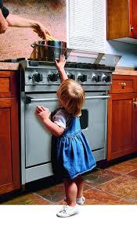
John L. Mackie modern development – the nature of the problem of evil (inconsistent triad)
Aquinas what we understand as goodness may not be what God understands as goodness. Goodness is relative to time and culture- we are limited
Imagine a toddler is curious when the parent is using the oven, toddler reaches up to try to pull the pan off the top of the oven to see what’s inside it, the parent smacks the child’s hand away from the oven , the child cannot understand why the parent smacked and is upset, he might think parent is unfair and unkind. Toddler is unaware the pan is full of hot water and would be in greater pain than a smacked hand. The Toddler does not see the parent’s perspective.
Largely rejected by Hume , effects of evil are felt too widely and is not dismissible
Mackie ‘Paradox of omnipotence’ Can an omnipotent being make things which he cannot subsequently control? Or make rules that binds himself
Mackie : the only solution deny that God is a continuing being or God is outside time

Slide 6
William Rowe (intense human and animal suffering) and Gregory S. Paul (premature deaths) The problem of evil and some varieties of atheism (1979)
Rowe could not accept intense suffering e.g. a fawn caught in forest fire.
An omnipotent and omniscient being would know when there is intense suffering
A being could prevent suffering
All loving being would prevent evil that had no purpose – such evil does happen
Therefore God probably does not exist.
Rowe’s approach is evidential problem of evil, different Epicurus and Mackie – logical problem of evil.
Gregory Paul , death of so many children challenges existence of God, since Abraham 50 billion children have died =‘Holocaust of the children’. How can an all loving- powerful God allow this? Therefore God does not exist

Slide 7
A02: The extent to which the classical form of the problem of evil is a problem.
Epicurus ‘Either God wants to abolish evil, and cannot; or he can; but does not want to. If he wants to but cannot, he is impotent if he can, but does not want to, he is wicked, If God can abolish evil, why is there evil in the world?’
Epicurean Paradox, denies that it is possible for such a God to exist alongside evil- the problem lies with the individual. Any who discounts the problem of evil sees is as no problem OR is a God of malevolence/limited power.
If a belief in an omnipotent God who has no fondness for humanity there is no contradiction OR a God is benevolent but is unable to remove evil

Slide 8
A02: The degree to which modern problem of evil arguments are effective in proving God’s non-existence
Mackie’s inconsistent triad, shows the incompatibility of God’s omnipotence/omnibenevolent with the existence of evil is an effective argument.
If there is suffering then a omnipotence/omni-benevolence God does not exist
But in line with Mackie God is able to function without the attributes such as benevolence then evil would exist as he does not care or unable to stop suffering.
Rowe: How can a omnipotence/omnibenevolent allow such horrors?
Paul: Allows the death billions of children since Abrahamic times.

Slide 9
Possible lines of argument
Modern problem of evil arguments are more effective than classical arguments in proving God’s existence

Slide 10
Possible lines of argument
Omni benevolence is less significant attribute than omnipotence when considering whether God id worthy of worship

Slide 11
Possible lines of argument
There are solutions to the modern problem of evil

Slide 12
Possible lines of argument
It is not God’s non-existence that modern problem evil arguments prove, rather it is God’s traditional attributes that are challenged.

Slide 13
Possible lines of argument
Modern problem of evil arguments are entirely ineffective in proving God’s non-existence.

