Slide 1
William James ‘Varieties of Religious Experience’ . These are instrumental observations of mystical experience.
B: Mystical Experience
William James

Slide 2
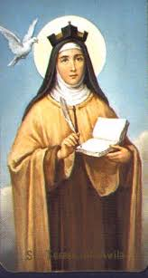
Ineffability
It cannot be expressed in words, it’s a direct experience and cannot be transferred to others. Its more about states of feelings rather than intellect. One must have musical ears to know a symphony. For example Teresa Avila. Just because it cannot be proved should not detract its value, it is more to do with the deficiency of the empiricist than the mystic.

Slide 3
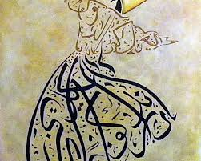
Noetic Quality- Sufi’s (Rumi) rational vs irrational
Mystical states seems to those who experience to be also states of knowledge. They are illuminations, revelations full of significance and importance.

Slide 4
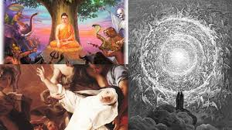
Transiency
Mystical states cannot be sustained for long. Often when faded their quality can be imperfectly reproduced from one reoccurrence to another.

Slide 5
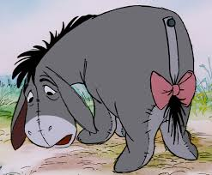
Passivity: Profound effect on the inner self
Mystical states may be facilitated by:
Preliminary voluntary operations
By fixing attention,
Going through bodily performances. This peculiarity connects with mystical states with certain definite phenomena. Mystical states are never merely interruptive , memory of the content remains and a profound sense of importance.
Events have a transformative effect.

Slide 6
Rudolf Otto – the concept of the numinous; mysterium tremendum, the human predisposition for religious experience

Slide 7
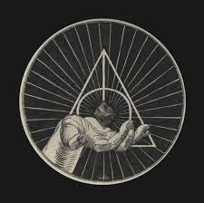
Otto: The idea of the holy: Harry Resurrection stone Dumbledore
Focuses on the feelings of recipient , Otto points out that ‘Holy’ has many connation's so he used the term ‘numinous’.
This refers to a ‘supernatural divine power’, the one who experiences the numinous is the one who feels the presence of a supernatural divine power.

Slide 8
Numinous- Platform 9 3/4
Otto believed that there is a significant dimension of human existence that is not rational, this experience is just as stable as rational experiences.

Slide 9
Mysterium Tremendum: Expecto Patronum
‘the deepest and most fundamental element in all strong and sincerely felt religious emotion’. Individual has had a profound effect; ‘the feeling of it may at times come sweeping like a gentle tide, pervading the mind with a tranquil mood of deepest worship’. A Deeply felt religious experience.

Slide 10
A02: Adequacy James four characteristics in defining mystical experiences
Ineffability: No adequate words can be used to express, would be empty to those who did not experience.
If we compare Otto’s numinous classification to James, Otto did not add anything new.
FC Happold, there is something that lies behind the usual experience. (consciousness of oneself of everything, sense timelessness, ego is not the real ‘I’.
St Bonaventure focuses on the process of mysticism, there are three mystic experiences:
Purgative- mystic is purified and prepared through meditation,
Illuminative stage mystic affected intellect and feelings.
Unitive stage mystic gains a union with God.

Slide 11
A02: The adequacy of Otto’s definition of ‘numinous’
Main issue is the basis of the definition and the implications: one essential experience vs just an experience.
Otto’s definition has very little to say about the nature of God or details about religious belief.
Its too vague and limiting
Its just a feeling
Otto convinced everyone has an encounter with the spiritual divine. But does not necessary involve visions/dreams.

Slide 12
A02
James four characteristics are adequate for defining mystical experience.

Slide 13
A02
James four characteristics in defining mystical experience are just one of many different ways of studying mystical experience.

Slide 14
A02
James four characteristics are more than adequate in defining mystical experience because they are a standard set in the study of mystical experiences.

Slide 15
A02
James four characteristics in defining mystical experience have been better developed and expressed by others.

Slide 16
A02
James four characteristics in defining mystical experience are adequate but not definitive.

