Slide 1
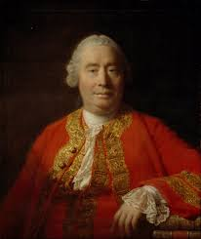
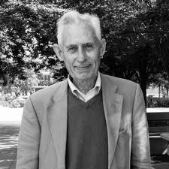
F Theme 3 Religious Experience
F: Contrasting views on the possibility of miracles : David Hume and Richard Swinburne

Slide 2
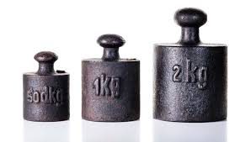
David Hume’s essay and his scepticism of miracles (1777) Watch Clip
Miracles could not demonstrate the truth of Christianity or religion in general.
Part 1 – philosophy grounds that the evidence against occurrence of purported miracle strongly outweighs the evidence of the occurrence.
Part 2 – In theory the evidence in favour could outweigh the evidence against it , in practice this never happens.

Slide 3
Hume and his challenge relating to testimony based belief
A wise person proportions their belief to the evidence, Hume examined the evidence for miracles. He concluded:
The experience has been constant then its full proof
Where its variable then it’s a case of weighing the proportionate probability of the experience having happened against not having happened.
Hume concludes that only testimony so strong its falsehood would itself be miraculous than the alleged miracle would convince him that a miracle has taken place.
Miracles are exceptional events, lying/being mistaken , the quality of the testimony would be needed to outweigh present day experience of the regularity of nature.

Slide 4
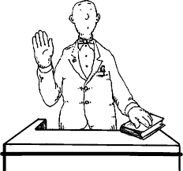
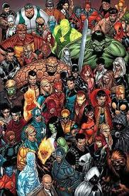
Challenges relating to the credibility of witness and susceptibility of belief
No miracle has a sufficient number of witnesses, quantity of educated , trustworthy witnesses ‘of such unquestioned good sense as to secure us against all delusions themselves’.
People are prone to look for marvels. A believer might know a miracle is false but perseveres it, with the best intentions , for the sake to promote a holy cause, they are biased and can be easily seen as a delusion.
Sources of miracle stories are from ignorant people . The miracle stories in the Bible lack authority, rationality , if it had emerged from a city of arts and knowledge than a remote country there might be some ground for a miracle.

Slide 5
Challenges relating to the contradictory nature of faith claims
Unreliability does not derive from witnesses but rather the evidence is further contradicted by other witnesses. For example if an Islamic miracle supports Islam and discredits Christianity and visa versa, this means miracles establish traditions but indirectly destroy other religions, they are self-cancelling as witness to the truth of a religious system.

Slide 6
Hume’s conclusions
No testimony will be sufficient to establish a miracle , this also means no miracle can be a just foundation for a religion.
Part 1 : that no testimony is sufficient to establish a miracle unless the testimony be such of a kind that is falsehood would be more miraculous than the fact which endeavours to establish’ – Priori (can you have a priori argument if it rests on experience?)
Part 2: it is more rational to distrust testimony about a miracle than to believe that the law of nature had been broken – Posteriori

Slide 7
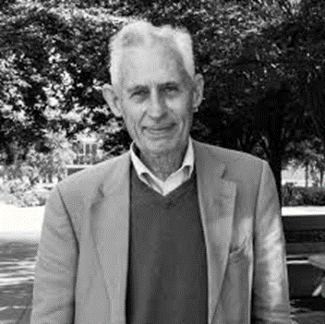
Swinburne’s definition of natural Laws: The concept of miracle (1970)
There can be evidence that a law of nature has been violated and rational belief in miracles is possible. He avoids ‘violation’ as there is a suggestion analogy between laws of nature and civil and moral laws.

Slide 8
Identifying a non-repeatable counter-instance to a law of nature
Event E occurred contrary to Predictions L , Similar events to E would not happen again , L is a law of nature
If modify law of nature to predict event E then will give false predictions in other circumstances.
If unmodified law of nature, will give correct predictions in all conceivable circumstances.

Slide 9
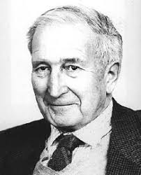
Can a non-repeatable counter-instance be believed to have happened?
What would be a good reason that event E has occurred? If event E is repeatable then we need to modify L to form a true law of nature.
Flew commented that Hume rejects historical witnesses if they can no longer examine historical witnesses personally.
Swinburne points out at any point historical and scientific evidence can be contested. Also with testimony its also about the character, mind of the witness.

Slide 10
A non-repeatable counter-instance identified as a miracle- it has to be God
If there is evidence of God , then event E is consistent with God’s character and unexplained, reasonable . If event E is consistent with God’s character and unexplained, then it is reasonable to believe that God caused the event. If the intentions are by a human being but not done by human beings, its justifiable to say its God.

Slide 11
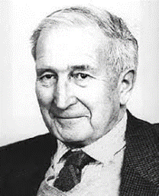
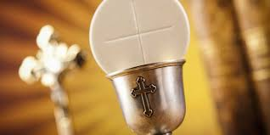
Contradictions of Hume’s arguments regarding contradictory nature of faith claims
If miracles in another religion tradition would destroy the evidence of that religion and visa versa. Swinburne points out that Hume argument would be valid if two miracles were in conflict and incompatible.
A devout RC Priest might pray for a miracle demonstrate transubstantiation , when the tabernacle containing the sacrament levitated
Protestant minister might pray to show transubstantiation is idolatrous. So they are conflicting accounts.

Slide 12
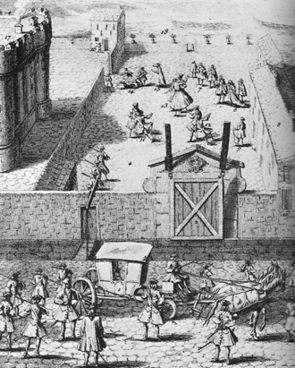
Contradictions of Hume’s arguments regarding credibility of witnesses
Swinburne accepts Hume’s three arguments against miracles and credibility of witnesses, but the standards of evidence are high. One of the miracles Hume’s essay Tomb of Abbe Paris.
Pilgrimages to the tomb of Pâris continued over the years 1727-1730. During this period, roughly a dozen pilgrims declared that they had been miraculously cured at the tomb. This number of miracle cures exploded in 1731. Over 70 cures were announced that year, from a variety of ailments which included paralysis, cancer, and blindness, among others. Not surprisingly, the number of pilgrims also grew rapidly during the summer of 1731. Miracles were not necessarily unusual in this period, but the connection with Jansenism was considered a cause for suspicion

Slide 13
Contradictions of Hume’s arguments regarding credibility of witnesses
Hume does not considers credibility of the witnesses the Tomb of Abbe Paris though there is exceptional quality. Hume rejects it as miracle through love of gossip and bias. Origins miracles being from ignorant nations,
Swinburne comments on Hume identifies ignorant nation as one believes miracles happen. Swinburne lists three principles for weighing conflicting evidence. WATCH CLIP
Swinburne:
Evidence different kinds ought to be given different weights, is a person drunk? Using your own memory
Different pieces of evidence ought to given different weights with any empirical evidence- reliability of testimonies.
Multiple similar testimonies from different witnesses ought to be given more weight from lesser number of contrary testimonies unless they all plotted the same false testimony.

Slide 14
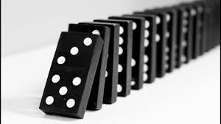
AO2: The effectiveness of the challenge to belief in miracles
Contingency miracles: no problem in believing natural events . A Theist would see God working through natural events. If events are random there is no reason to think the events have any significance , unless they had prior belief in God?
A divine agent is necessary to cause of an event, to use the term miracle should not be used.

Slide 15
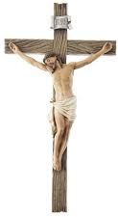
AO2: The effectiveness of the challenge to belief in miracles
Has a law of nature been broken? Swinburne define a miraculous event as the occurrence of a non repeatable counter instance to a law of nature, are the laws of nature broken? Neither theist/naturalist position can be falsified
Hume said it was unreasonable to believe in miracles, if law of nature is not broken than to believe the testimony? But there are miracles not involving the supernatural , what if resurrection may have accounts written after the event and it was not literal? What if they were written by people of vested interest?
Hume decided it was unreasonable to believe in miracles regardless of evidence

Slide 16
AO2: The effectiveness of the challenge to belief in miracles
Testimony is not the evidence for miracles? What God does not intervene in our world ? Or that Theists pray and we ask for God’s support? Miracles break laws of nature , this is the means of which God sustains the universe.
Miracles limit God’s time, interventionist God is contrary God is a preserver of the Universe. This is incompatible with God being outside time.
Problem of Evil, If God is able to intervene why does he not address the real problems of the world? Maurice Wiles – a God that acts in a trivial way is a God not worthy of worship.

Slide 17
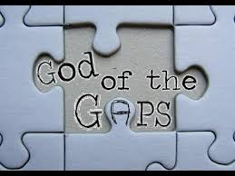
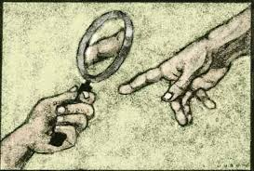
AO2: The effectiveness of the challenge to belief in miracles
Miracles contradict science, to conclude God intervened it is a ‘God of gaps’ argument. Science may have unanswered questions but they are not explained.
However on occasions science predictions based on laws that are incorrect, science is not the ultimate authority. A miracle might have occurred while there is a possibility that evidence might come later. Do we need to widen natural laws?

Slide 18
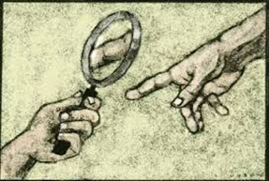
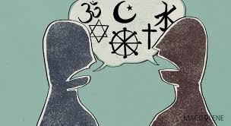
AO2: The extent to which Swinburne’s responses to Hume can be accepted as valid
Hard interpretation: it is not clear why Hume argued against reliability of testimony. Hume records witnessed by people with unquestionable testimony yet refused to credit and regardless of evidence.
Science methodology has limitations, it does not have the authority to rule that a miracle has occurred.
Swinburne's definition ‘purpose’ is important – shows religious signs. Miracles of one religious tradition , does it destroy another? Swinburne disagrees as they are from different traditions. God reveals himself in different ways to different people

Slide 19
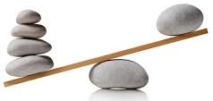
AO2: The extent to which Swinburne’s responses to Hume can be accepted as valid
A weakness Hume’s argument about the quality of witnesses, what is sufficient ? Is it the number? Tomb of Abbe Paris – people who had witnessed had unquestionable integrity. Hume rejects miracles regardless of evidence. But Hume is empiricist, so raises the question about the weight of the evidence.
Swinburne was correct drawing attention different weighting , Hume does seem to imply that all believers are deceivers, can miracles be investigated historical research but cannot be detected by empirical historical research.
Swinburne: we should expect miracles since God needs to communicate with his servants, God is responding to prayer. Can God enter time?

Slide 20
Activity: Hume and Swinburne
Devise a radio interview between Swinburne and Hume.
What does each scholar say about miracles?
What questions will you ask?
Make sure you include the critiques of each other. Present a line of enquiry and support it with evidence.
Evaluate whether they are strong or weak arguments.

