Slide 1
Title: Finnis’ Natural Law and Hoose’s Proportionalism: application of the theory
Overview for this section
Candidates need to apply the theory they have learnt in sections 2D and 2E to both ethical issues of immigration and capital punishment.
A detailed overview of how the various aspects of Finnis’ Natural Law (with reference to the appropriate elements of the seven basic human goods, the nine requirements of practical reason and the common good) and Hoose’s Proportionalism (only breaking a principle if there is a proportionate reason and based on agape love) apply to these two ethical issues is needed.
Candidates should focus on the application of the theory to the issues and not on a broad and detailed description of the ethical issues themselves.

Slide 2
Immigration
What is it?
Why would people immigrate?
What could be some of the issues arising from immigration?
What reasons can you give for immigration being a good thing?
What reasons can you give for immigration being a bad thing?

Slide 3
What is it?
Immigration
  the action of coming to live permanently in a foreign country.
Emigration
  the act of leaving one's own country to settle permanently in another; moving abroad.
The difference between “immigrate” and “emigrate” is
  “immigrating” is the act of entering a foreign country to live while “emigrating” is the act of leaving a country to live in another.

Slide 4
Illegal immigration (also referred to unauthorized or undocumented immigrants)
  the migration of people across national borders in a way that violates the immigration laws of the destined country

Slide 5
Why would people immigrate?
Push factors
  Economic
    No work
    No resources
    Poor education
    Services that provide a longer life expectancy and life opportunities
    Weak infrastructure
    Poverty (LEDCs)
  Political
    Government opposed to your views
    Dictators
    Seeking refuge or asylum from conflict or persecution
Pull Factors
  Economic
    More jobs
    Resources
    Free and effective education
    Medical care
    High Standard of living (MEDCs)
  Political
    Freedom of beliefs and actions
    Democracy that allows your views to be aired
    A country with a good record of Human Rights or one free of conflict

Slide 6
Why would people immigrate?
Push factors
  Environmental
    Current flooding, droughts, earthquakes etc
    High risk of natural disasters in the future (unstable)
    A climate inappropriate for growing food
    A climate inappropriate for growing goods to export
Pull Factors
  Environmental
    No current natural disasters
    Stable environment with low future risks
    A climate that allows food to grow
    A climate appropriate for growing goods to export

Slide 7
Issues
Illegal Immigration
Risking life to move
  What is the action that is the least ‘risky’?
Breaking the law
  Should the law be kept in this case?
  If it damages pursuits of the Basic Goods (Finnis), or creates disproportionate results in terms of agape (Hoose) is it a law we should adhere to?
Funding criminal gangs to move
  Can this sort of migration ever be moral?

Slide 8
Issues
legal Immigration
Changes in demographic and culture
  Are we undermining Basic Goods by allowing this?
  Is this proportionate in terms of agape?
Migrant crises for the countries receiving the immigrants?
  Economic consequences
  Problems with demands on infrastructure
    Public services: transport, education, housing, healthcare
    Are we undermining Basic Goods in this way?
    Is this proportionate in terms of agape?

Slide 9
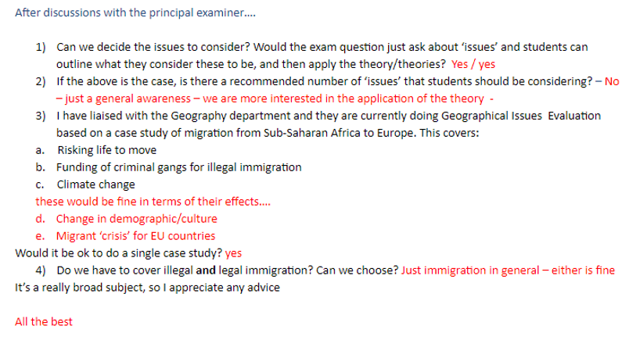
Notes:
Email from Andrew Pearce

Slide 10
Theme 2F:Applying Finnis’ Natural Law to Immigration
Lesson Objectives:
Questions for this lesson
How do the seven basic human goods apply to immigration?
How do the Nine Requirements of Practical Reason apply to immigration?
How does the Common Good apply to immigration?
Starter: Consider the previous discussions, do you think Finnis’ Natural Law would say immigration is a moral act?

Slide 11
Starter
“Finnis’ Natural Law would justify immigration.”
AGREE
DISAGREE
Notes:
Students should spend 5 minutes in pairs trying to form a response to the quote. They should write their response on a post-it and stick it on the agree to disagree line on the board.

Slide 12
Make notes on the following: Why should we welcome immigration?
https://www.youtube.com/watch?v=LPjzfGChGlE
https://www.youtube.com/watch?v=Y1sdIHbkHEw
https://www.youtube.com/watch?v=7oOmA09unRM

Slide 13
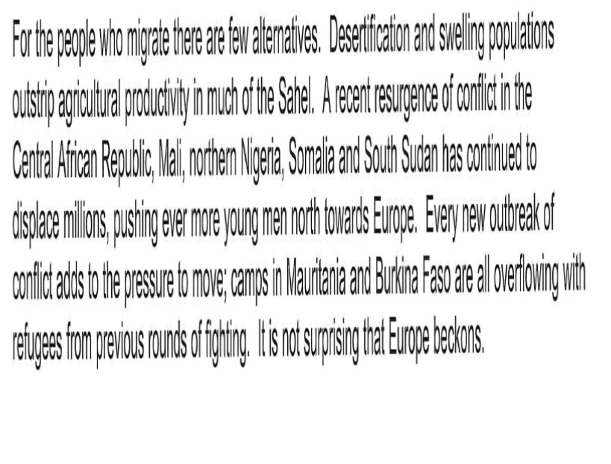
Case Study: Migration from Sub-Saharan Africa to Europe

Slide 14
Case Study: Migration from Sub-Saharan Africa to Europe

Slide 15
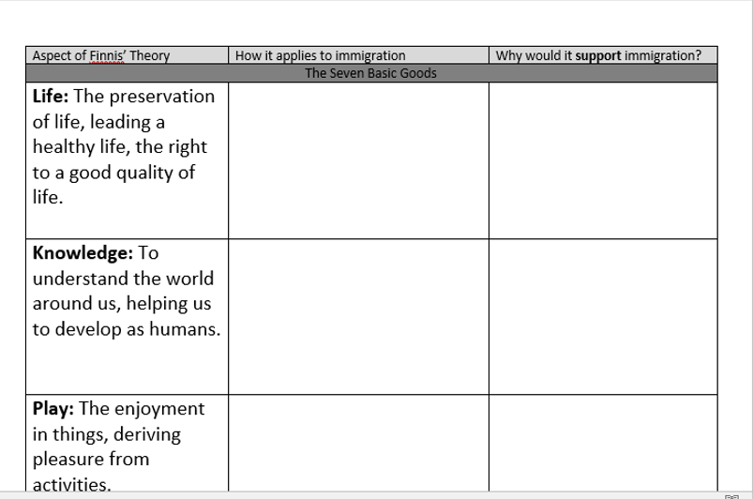
Task: Use your notes to explain how Finnis’ seven Basic Goods, and Nine Requirements of Practical Reasonableness would mean immigration is moral and should be allowed

Slide 16
Make notes on the following: Why should we not welcome immigration?
https://www.youtube.com/watch?v=LPjzfGChGlE
https://www.youtube.com/watch?v=1ehGhwfd4sM
https://www.youtube.com/watch?v=fWTOaYKp-Aw

Slide 18
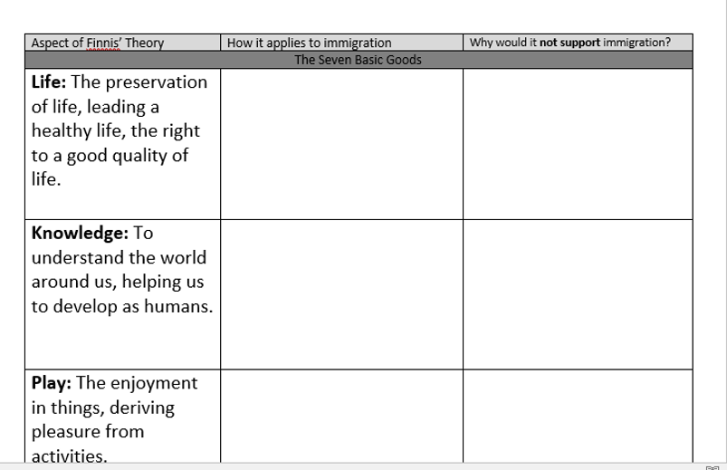
Task: Use your notes to explain how Finnis’ seven Basic Goods, and Nine Requirements of Practical Reasonableness would mean immigration is immoral and should not be allowed

Slide 19
Do you still feel the same?
“Finnis’ Natural Law would justify immigration.”
AGREE
DISAGREE

Slide 20
Finnis’ Natural Law
Finnis disagrees with immigration or the lack of controls on immigration.
Finnis warns about the imminent demise of (European, Anglo-American) civilization posed by the aliens at the gates, the yellow peril, the Muslim hordes, the Mexican labourers.
He thinks Western societies are quickly going to pot, and he lays some of the blame for this on loose immigration policies.

Slide 21
Finnis’ Natural Law
European states in the early twenty-first century move ever more clearly out of the social and political conditions of the 1960s into a trajectory of demographic and cultural decay, circumscription of political, religious and educational speech and associated freedoms; pervasive untruthfulness about equality and diversity; population transfer and replacement by a kind of reverse colonization; and resultant international fissiparation foreshadowing, it seems, ethnic and religious inter-communal miseries of hatred, bloodshed and political paralysis reminiscent of late twentieth century Yugoslavia’s or the Levant’s.
John Finnis from his essay on the political philosophy of H.L.A. Hart

Slide 22
How is Finnis applying his Seven Basic Goods and Nine Requirements of Practical Reasonableness in order to show that FREE immigration should not be allowed?

Slide 23
Theme 2F:Applying Hoose’s Proportionalism to immigration
Lesson Objectives:
Questions for this lesson
How does Hoose’s proportionalism apply to immigration?
Starter: Do you think Hoose’s Proportionalism would say immigration is a moral act?

Slide 24
Starter
“Hoose’s Proportionalism would justify immigration.”
AGREE
DISAGREE
Notes:
Students should spend 5 minutes in pairs trying to form a response to the quote. They should write their response on a post-it and stick it on the agree to disagree line on the board.

Slide 25
What are the costs and benefits of immigration
https://www.youtube.com/watch?v=by2dTCj-qdk

Slide 26
Proportionalism
Immigration does allow for some of the ontic (real) goods – qualities such as dignity, integrity and justice – which themselves are not moral but are desirable qualities and should be taken into account when making a moral decision.
However, if immigration can cause harm to others, as we have seen Finnis has tried to show, it could not be justified.
All possible consequences need to be considered to decide whether or not it can be justified.

Slide 27
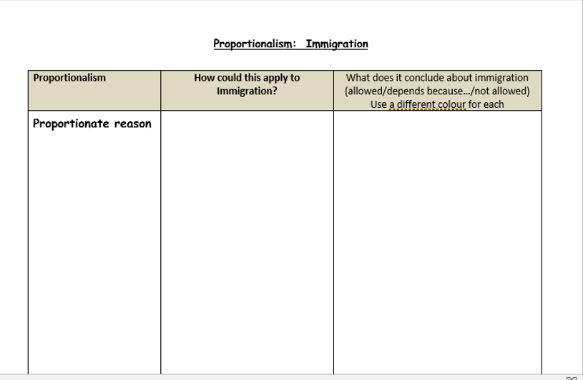
Task
Apply the principles of proportionalism and agape to immigration
Notes:
worksheet

Slide 28
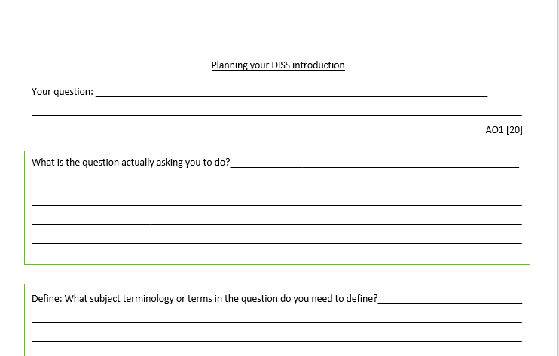
Exam question
Explain how Finnis’ Natural Law would apply to immigration [20]
Is this AO1 or AO2?
What must you do?
Plan your DISS

