Slide 1

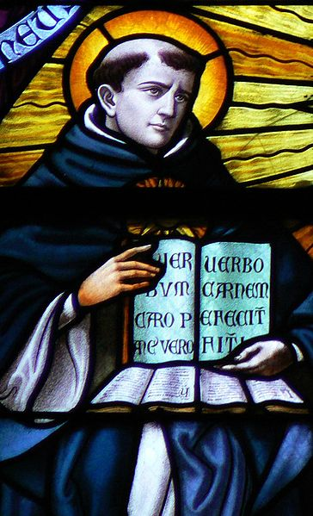
Who was Thomas Aquinas?
(born ca. 1225; died 7 March 1274) an Italian priest of the Roman Catholic Church in the Dominican Order, and an immensely influential philosopher and theologian in the tradition of scholasticism, known as Doctor Angelicus and Doctor Communis. He is frequently referred to as Thomas because "Aquinas" refers to his residence rather than his surname. He was the foremost classical proponent of natural theology, and the father of the Thomistic school of philosophy and theology. His influence on Western thought is considerable, and much of modern philosophy was conceived as a reaction against, or as an agreement with, his ideas, particularly in the areas of ethics, natural law and political theory.
Aquinas is held in the Catholic Church to be the model teacher for those studying for the priesthood.^{[1]} The works for which he is best-known are the Summa Theologica and the Summa Contra Gentiles. One of the 33 Doctors of the Church, he is considered by many Catholics to be the Church's greatest theologian and philosopher.

Slide 2
CLICK HERE -Thomas Aquinas (1224-1274)
Augustine of Hippo, equated natural law with man's prelapsarian (pre-fall) state; as such, a life according to nature was no longer possible and men needed instead to: seek salvation through the divine law and grace of Jesus Christ.
BUT...
Thomas Aquinas restored Natural Law to its independent state, asserting that, as ‘the perfection of human reason’, it could approach but not fully comprehend the Eternal Law and needed to be supplemented by Divine Law (as found in the Bible).

Slide 3
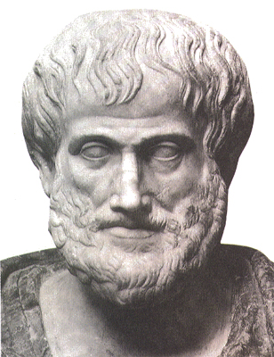
Aristotle (384 BC-366 BC)
Aristotle distinguished between (universal) natural justice and (Local) legal justice.
What the law commanded varied from place to place, but what was "by nature" should be the same everywhere. A "law of nature" would therefore have had the flavor more of a paradox than something which obviously existed.
Plato and Aristotle, posited the existence of natural justice or natural right. Of these, Aristotle is often said to be the father of natural law.
Can you think of an example?

Slide 4
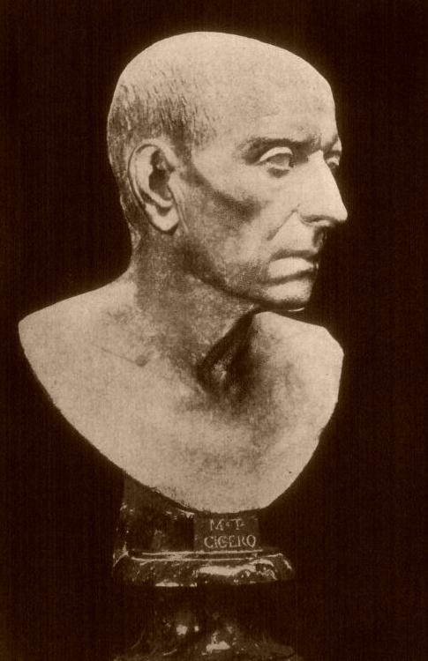
Cicero (106-43 BC)
"True law is right reason in agreement with nature; it summons to duty by its commands, and averts from wrongdoing by its prohibitions. And it does not lay its commands or prohibitions upon good men in vain, though neither have any effect on the wicked. It is a sin to try to alter this law, nor is it allowable to attempt to repeal any part of it, and it is impossible to abolish it entirely.
We cannot be freed from its obligations by senate or people, and we need not look outside ourselves for an expounder or interpreter of it.
And there will not be different laws at Rome and at Athens, or different laws now and in the future, but one eternal and unchangeable law will be valid for all nations and all times, and there will be one master and ruler, that is, God, over us all, for he is the author of this law, its promulgator, and its enforcing judge.”
What example can you think of?

Slide 5
What is the Natural Moral Law?
It is a deductive (a priori) theory – it starts with PRIMARY principles, and from these the right course of action in a particular situation can be deduced.
It is a deontological ethic (absolute rules), looking at the intent behind an action and the nature of the act itself, not its outcomes.

Slide 6
What is the Natural Moral Law?
A theory that proposes the existence of a law whose content is set by nature, derived from God and that therefore has validity everywhere

Slide 7
Aquinas and Natural Law
Natural Law is often misunderstood as a distinctively Catholic theory, although it has been adopted by non-Catholic thinkers, such as Richard Hooker.
As a theory is predates Christianity. Therefore it could in principle be defended without reference to religious belief.
Natural Law appeals to the sense that certain things can clearly be known by anyone to be wrong. Eg. Incest.
Richard Hooker: 1554-1600, Church of England priest and theologian.

Slide 8
Natural Law
The idea of Natural Law is very ancient. Aristotle wrote about it and it informed much of Stoic thought.
At it’s core is this:“the law is written on men’s hearts.”- Romans 2:15, the belief that all of humanity can find a common idea of rightness.
Aquinas believed that what is right is knowable by reason alone. He rejected Divine Command Theory
He believed morality is rooted in reason, not in scripture. He did believe that morality was justified by scripture.
The Stoics: included both Greek philosophers and Romans. They believed that as we can’t do anything to change our human luck, we must cultivate the right attitudes and acceptance.

Slide 9

The Purpose of Life
First step of Natural Law = to find out the purpose of human life
Aristotle’s purpose was happiness
Aquinas decided it was perfection
as God is perfect and humans are made in the image of God (oh, and in order to be preserved beyond the grave!)

Slide 10
Aristotle’s Influence on the Thinking of Aquinas
  all things have a PURPOSE to which they work
  therefore
  an examination of:
            1. the natural world (by reason)
            2. the Bible (by revelation)
  reveals God’s purpose in creating man

Slide 11
The Purpose (goal) of the ‘good’
All human behaviour is done to achieve some purpose called a ‘good’.
All these goods aim to the Highest Human Good.
Since God is perfect and man is made in the image of God this ultimate must be PERFECTION.
In his book Summa Theologiae Aquinas seeks to work out what ‘perfection’ actually is.
He does this through the study of the Bible (Divine Law) and Human Nature (Natural Law).

Slide 12
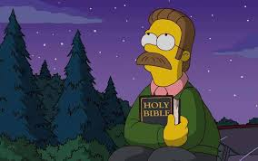
Telos
For Aquinas, and Aristotle, the universe has a purpose, and therefore things seek to achieve their purpose, (telos) plants and animals do this instinctively.
For Aristotle, our earthly purpose is to flourish in community. He had no belief in personal survival after death.
For Aquinas, we achieve our purpose in the next life, so our goal is to live this life in faithful service to God.

Slide 13
Aristotle
For Aristotle, our goal is to flourish, which leads to happiness. (eudaimonia)
For Aquinas, this is not sufficient. Happiness in the fullest sense as union with God.. Our goal is therefore our heavenly home.
This can suggest that Aquinas regards this life as irrelevant, which isn’t the case. It wholly matters how we live on this earth as it is a foretaste of what is to come. He thought there was a Prime Mover in the universe responsible for setting it in motion, God is the Prime Mover.
How does Homer reach Eudemonia? Does it fit with Aquinas’s notion of a Prime Mover?
Eudaimonia: a full flourishing of the human person and his abilities.

Slide 14
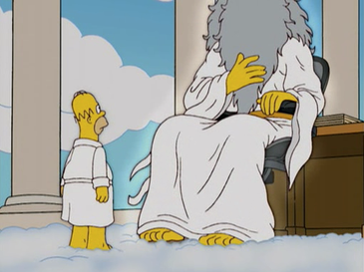



Thomas Aquinas, at the heart of law, created a four fold division:
Eternal Law: refers to underlying principles of the universe which only God fully knows.
Divine Law: refers to God’s law revealed in the Bible.
Natural Law: contains primary precepts
1 the desire to live and survive (all living things)
2 to reproduce and bring up the young (humans and animals)
3 to know and worship God and to live in an ordered society (humans)
Human Law:
Secondary precepts are detailed rules, derived from primary precepts. Eg. The wrongness of adultery, protection of innocent life. These are not self evident.

Slide 15
The Four tiers of law: The Eternal Law
There are Primary Principles by which God made and controls the universe (only fully known by God)
This includes the Scientific Laws (governing nature), Moral Laws (governing human behaviour)
Humans can know these eternal laws in their ‘reflection.’
E.g. We can’t look into a bright light but can see it in a reflection on water. There is not a perfect representation but it is approximate.

Slide 16
1. Eternal Law
Should not be confused with divine command theory
What Aquinas means by Eternal Law is that God made the universe to be of this kind, and not something different.
He made human beings to be social and mortal.
Humans cannot fully understand God’s Eternal Law but through reason, we can work out its meaning in human life
Eternal Law: refers to underlying principles of the universe which only God fully knows.

Slide 17

2. Divine Law
Nothing in Divine Law contradicts Natural Law
In scripture, the Ten Commandments are not new teachings, but to remind people of what they should already know.
Therefore, Divine Law affirms what we know through reasons, and therefore, non-Christians should also know the divine law through reason.
Divine Law: refers to God’s law revealed in the Bible. (ten commandments, sermon on the mount)

Slide 18
The Four tiers of law: The Divine Law
The Divine Law is found in the Bible.
Aquinas believed that it reflected the Eternal Law of God in that it reflects the moral laws.
Not everybody can see this reflection as it is supernatural. We can see our origin and purpose in it as well as our true identity as being made in the image of God.

Slide 19

3. Natural Law
Natural Law follows the direction of Eternal Law.
It is a rational exercise to work out what is good for human flourishing.
Aquinas refers to this as human nature.
Natural Law: contains primary precepts
1 the desire to live and survive (all living things)
2 to reproduce and bring up the young (humans and animals)
3 to know and worship God and to live in an ordered society (humans)

Slide 20
The Four tiers of law: The Natural Law
Refers to those moral laws of God built into the structure of Human Nature and which are sometimes referred to as the
‘law written on our heart’.
To be fully human it is necessary to obey these laws which are reflections of the Eternal Law.
However these ‘reflections’ are not as complete as the Divine Law as they do not reflect the spiritual dimension of life.
E.g. To live, to reproduce, to learn, to have an ordered society.

Slide 21

4. Human Law
Human Law arises from the reality that humans are social beings and therefore we need regulations to function cooperatively.
Human Law’s value is essentially dependent on not contradicting Natural Law. Any law that contradicts Natural Law cannot be justified.
E.g. If someone refuses to assist an abortion, we can accept that as a matter of conscience. If someone refuses to obey the law not to park on double yellow lines, that would seem odd.
Human Law:
Secondary precepts are detailed rules, derived from primary precepts. Eg. The wrongness of adultery, protection of innocent life. These are not self evident.

Slide 22
The Four tiers of law: The Human Law
Human Law is only law if it is in accordance with divine and natural law, Not all of morality is covered.

Slide 23
Questions and Concept Checking
Explain the relationship and the differences between the Eternal Law, Divine Law, and Natural Law.
Explain where God’s Natural Law can be found and how it is capable of revealing to us how we ought to behave in this world.
This PowerPoint has used the analogy of the house to clarify the concept of the Natural law. Using the analogy of a car explain the same idea.

Slide 24

The Key Precept: The Synderesis Rule
It relies on Aquinas' basic understanding that humans innately try to do good and to avoid evil in order to find fulfilment and happiness in life (Synderesis Rule).
To what extent does Luke fulfil the Synderesis criteria?

Slide 25
Primary & Secondary Precepts
The primary precept of Natural Law is to do good.
Other points, including the secondary precepts, follow from this initial point.
The value of relationships and the education of children:
  are self evident as they help to preserve life and enable a flourishing life.
  There is more to the quality of life than being alive.
  Humans are social creatures, we flourish in community.
Implicit in this reading, is the need to cultivate those virtues which encourage the right habits to flourish.

Slide 26
Primary Precepts
The purpose of humans -
In four words, 'Do good, avoid evil'. In more detail, Aquinas talked of Primary Precepts. Whilst you probably think of Natural Law as a deontological position (deon- duty; deontological ethical positions have absolute rules that it is our duty to follow), this part is teleological. Telos- purpose. What is our purpose - what are we designed for? What follows is an acrostic, which I have arranged so it makes a word.
Worship God
Ordered society
Reproduction
Learning
Defend the innocent

Slide 27
Primary & Secondary Precepts
Commentators of Aquinas have implied 5 broad areas of moral conduct:
Preservation of life
Ordering of society
Worship of God
Education of children
Reproduction.
Are these precepts intrinsic to the idea of doing good and avoiding evil?
These are often described as the 5 Primary Precepts, although Aquinas never used this term.

Slide 28
Primary & Secondary Precepts
From these come secondary precepts, which are determined by human reason.
for example:
  Do not murder (fulfills the precept of preserving life)
  Only have sex within marriage (fulfills the precepts of educating our children and ordering society)
It is important to note that Aquinas did NOT come up with a list of primary and secondary precepts- he was not specific in these at all. These have been created by others, and is an example of how Natural Law has been treated more legalistically than it was intended.

Slide 29
Secondary Precepts
These are the rules - absolute deontological principles - that are derived from the Primary Precepts.
For example, the teleological (purpose) principle "Protect and preserve the innocent" leads to absolute rules such as "Do not abort," "Do not commit euthanasia" etc. These rules cannot be broken, regardless of the consequences. They are absolute laws.
Likewise ‘Marry and multiply’

Slide 30
Questions about Precepts
Explain the distinction between Primary and Secondary precepts
Do you agree with St Albert that the function of sex is to have babies?

Slide 31
PRIMARY PRECEPTS ARE DESCRIPTIVE; SECONDARY PRECEPTS ARE PRESCRIPTIVE.

Slide 32
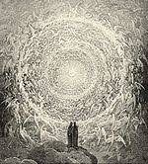
The Role of Virtues and Goods in supporting moral behaviour (Articles of Faith) These virtues enables human beings to strive for perfection, Beatific vision (state happiness through supernatural union with God)
Faith is an act of will, intellect which assents the divine truth.
Hope : Constant and consistent trust in the beatific vision.
Love (Charity) Agape : Does The Macklemore/Lewis uphold Natural virtues? Look at Corinthians 1

Slide 33
Exterior (the act itself) and Interior (intention of the act)
If a good act results in bad consequences then it is still right to do the act.
How does this apply to Abortion?

Slide 34
Causistry and Double Effect
Causistry = the process of applying Natural Law principles to specific situations.
This is done in a logical way, as some principles have logical consequences.
E.G If it is in principle wrong to kill innocent human beings, it follows that bombing civilian targets (such as Dresden in WW2) is wrong. However, if it is accepted that killing in self-defense is okay, we could justify an air attack on Afghanistan on these grounds. Innocent people might die, but that is not the aim of the action, so the doctrine of double effect comes in to play.
Double effect = intended outcome has another unintentional outcome.
According to Natural Law, it is our intentions that are important, not the consequences of our actions. Double effect would not allow you to perform an action where an unintended outcome had devastating effects. The unintended effect has to be PROPORTIONATE. What this actually means, critics say, is that Natural Law becomes like Utilitarianism.

Slide 35
Double Effect- H/W Read Philippa Foot- How does the Double effect relate to the Trolley Problem?
The principle of double effect is the idea that many actions have more than one result.
Aquinas had two questions about decision making: What is the motivation? What does reason tell us to do?
Any judgement should be based on intention and the use of right reason in reaching the decision.
Hugely debated in medical dilemmas, particularly euthanasia.
The Principle of Double Effect: an act may have more than one effect and should be known to have more than one.

Slide 36
Double Effect
Four principles are normally required for the principle of double effect:
The act must not be evil in itself. Killing is not intrinsically wrong in the way murder always is.
The evil and good that come from the situation must be at least equal. Good outcomes should outweigh outcomes.
The intention of the agent must be good.
A proportionally serious reason must be present to justify the indirect bad outcomes.

Slide 37
Double Effect
Proportion is incredibly important- Aquinas insists on this.
I believe that a principle of double effect must form part of any rational system of morality, and it has many everyday applications. There are cases where it makes a huge difference whether an outcome is intended or merely foreseen. For instance, there is nothing wrong with appointing the best person for the job even though you know that by doing so you will give pain to the other candidates. It would be a very different matter if you appointed A (even though the best candidate) for the express purpose of giving pain to B.
Anthony Kenny: What I believe (2006), p. 90

Slide 38
Real and Apparent Goods
Following a ‘real’ good will result in the preservation or improvement of self, getting nearer to the ‘ideal human nature’ that God had planned. There are many apparent goods that may be pleasurable (e.g. drugs) but ultimately lead us to fall short of our potential. Reason is used to determine the ‘real’ goods.

Slide 39
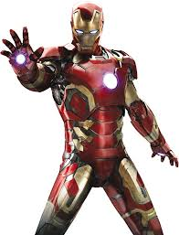
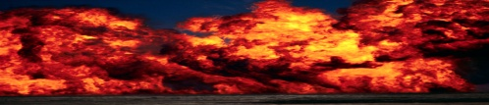
Real and Apparent Goods
Perfection
Prudence - able to judge between actions with regard to appropriate actions at a given time
Justice- proper moderation between self-interest and the rights and needs of others
Temperance- practicing self-control, abstention, and moderation
Courage or Fortitude - forbearance, endurance, and ability to confront fear and uncertainty, or intimidation
Vices
Virtues
To what extent does Iron Man/Tony Stark demonstrate
REASON DISCERNS REAL ‘GOODS’
wrath, greed, sloth, pride, lust, envy, and gluttony
E.g. ‘A fornicator seeks a pleasure which involves him in moral guilt.’ (Summa Theologiae)
Judgement

Slide 40
Real and Apparent Goods
‘the theologian considers sin principally as an offence against God, whereas the moral philosopher considers it as being contrary to reason.’
(Summa Theologiae)

Slide 41
Real and Apparent Goods
Deliberate Moral Choices = ‘Human Acts’
‘right use of reason’
‘Interior Acts’ = Most important = morally good or bad acts
(and depends on the intention)
E.g. ‘...to give alms (charity) for the sake of vainglory is bad.’
The ultimate aim has to be God by which to test the will. If the end is money or power, ambition etc the end is wrong.
‘Exterior Acts’ = Less important

Slide 42
Four Cardinal Virtues
Aquinas argued that the self should be maintained. As a result, Natural Law supports certain virtues (prudence, justice, fortitude and temperance) that allow the self to fulfil its purpose. Similarly there are many vices (the seven deadly sins) that must be avoided as they prevent the individual from being what God intended them to be.

Slide 43
Apply the Four Cardinal Virtues
Prudence : Wisdom concern human affairs , rational evaluation in circumstances
Temperance: Moderation, Aristotle’s Doctrine of the mean
Fortitude/Courage: Discipline , endurance, patience , will not be beaten down.
Justice: Covers the law, how we govern our actions
How does the Cardinal Virtues apply to Dobby in Harry Potter?

Slide 44
Does Natural law provide a helpful method of moral decision making today?
Natural Law offers legalistic way what is morally right, link the immediate moral dilemma to a bigger general rule.
It provides moral rules which can be applied to different situations. It offers clarity and consistency in a relativistic world.
Primary Precepts are inspired by religious belief in God, which makes them potentially unhelpful for those who do not believe in God, does the world have purpose?, world is chaotic and random and unpredictable with no divine authority.
Children need to be educated and then want to protect life. But human reason is capable coming up with new explanations for observed phenomena's e.g. quantum physics.

Slide 45
Does Natural law provide a helpful method of moral decision making today?
Conscience: Natural provides a foundation in which you can build moral rules. However Critics says it can put you in a box, a simplified human behaviour. It misses the complexity human behaviour, Natural law guides us to follow social conventions. E.g. Sexual Production: is necessary but how about women who die after childbirth.
Natural Law has a rationale for Human Rights providing basis world justice, all people are protected.

Slide 46
Does Human nature have an orientation towards the good.
Aquinas has a positive view of human nature, there is natural response to do good. Moral laws arise out of a natural response and support the view of a world where life flourishes, we need order to prevent chaos, people are interested in protecting life.
Hobbes saw Human Nature as dangerous and murderous, to survive human nature needs to be limited, if allow complete freedom it would be destructive.
Humans are damaging the natural world through population, what is good is the result of mass human activity? What is the natural urge is towards self preservation?

Slide 47
Can a judgment about something being good, bad, right and wrong be based on its success or failure in achieving its telos?
A good person is a person who fulfils their purpose. This is a theory by the Catholic Church and informs moral thought, it prohibits Artificial contraception, Masturbation and homosexual sex, where does rationality fit in?
But Natural Law uphold universal human rights

Slide 48
Has the universe as a whole been designed with a Telos?
Natural assumes a fixed and designed world.
But Science has no place for a creator, The world is chaotic and dynamic.
Telos in natural order is difficult to understand. Hans Kung idea of natural is naïve , arbitrary such as sexuality. Fixed sexualities when we have issues about transgender, Kung says natural law attach a biological and physical structure which does not induce reason.

Slide 49
Can the doctrine of double effect be used to justify an action, such as killing someone as an act of self-defence?
It allows a person to intend for one thing to happen whist there is another outcome, for example I am attacked, I defend my self to protect life. I do not act against Natural Law but to uphold it, it could allow self defence, perhaps our good intentions lead us astray?
Useful in difficult decisions, distinguish between intentions and that actions take place. Deontologists interested in actions, an act to save a life has one intention.

Slide 50
AO2:Objections to Natural Law
2. It’s vague
  It doesn’t make it clear about what should be done as clearly as other ethical theories.
  Therefore is doesn't’t enable us to be certain in significant cases. For example, the principle of saving life.

Slide 51
AO2: Objections to Natural Law
2. Unclear conclusions
  The issue of vagueness means that it may be possible to construct natural law arguments that point in opposing directions.
  A good example is the issue of contraception.

Slide 52
AO2: Objections to Natural Law
3. An Un-Christian Theory
  Many Protestants have argued against Natural Law as ultimately unbiblical.
  John Calvin looked to Scripture as the Word of God as a principle source of moral teaching.

Slide 53
AO2: Objections to Natural Law
4. Acceptance
  If Natural Law is based on “right reason” and this is accessible to all, one would expect people to accept this teaching more widely.
  “it is….not a law in any known sense of the word, not an ‘is’ but an ‘ought’, a ‘pattern laid up in heaven’, and thus inaccessible save through interpreters. Christians may answer that it is a law, a law laid down by God in pre-Christian days and not abolished, though crowned, by the Christian revelation with its laws. We shall certainly not be able to convince non-Christians, or even all Christians, that such a law exists, and the most difficult part of the argument revolves around its content.”

Slide 54
AO2: Objections to Natural Law
5. A Purposive Universe?
  one of the criticisms is the reliance on Aristotle’s belief that everything has a purpose.
  Any theory of natural law is doomed is the metaphysic on which it stands, is mistaken.
  Other more recent natural law theorists have attempted to deal with this by focussing on the nature of human beings, rather than purpose.

Slide 55
'Natural Law is not an effective way of making moral decisions.’

