Slide 1
Meta-ethics
Introduction - Naturalism

Slide 2
Meta-ethics
This is part of the Ethical Thought theme.
We have studied Divine Command Ethics, Virtue Ethics and Egoism.
In this half of the theme, we will be thinking about the meaning of the word ‘good’ and whether goodness can be known cognitively or not.
We will study naturalism, intuitionism and emotivism.
Notes:
Put the topic into context of wider studies

Slide 3
What is meant by meta-ethics?
‘meta’ means beyond.
In meta ethics, we go beyond questions of what is good or bad to think about what we mean when we say something is good or bad and how we know something is good or bad.
Meta-ethics analyses the language we use when we speak about morality and asks whether it has any meaning. If it does, where does the meaning come from? If it does not, why not?
Because it is concerned with how we know what is good or bad, it is linked to moral epistemology. Epistemology is the study of how we know things.
Notes:
Explain what meta-ethics is.

Slide 4
You are already familiar with many of the key terms for this topic
Match the word with its meaning
A Cognitive
B Realist
C Empirical
D Objective
E Logical positivism
F Proposition
has a separate existence and truth independent of personal feeling or situation.
the view that the world around us actually exists.
the view that for a statement to have meaning, it must be verifiable either by logic or by experience (aka verification principle)
A meaningful, declarative statement
knowable through experience or the senses.
based on evidence
Notes:
Students should be able to match these up as a recap. It will reassure them that they will be revisiting familiar ideas. The only one they have not met before is proposition, but by a process of elimination they should be able to establish this.

Slide 5
Key terms
Cognitive – knowable through experience or the senses.
Realist – the view that the world around us actually exists.
Empirical – based on evidence
Objective – has a separate existence and truth independent of personal feeling or situation.
Logical positivism – the view that for a statement to have meaning, it must be verifiable either by logic or by experience (aka verification principle)
Proposition – a meaningful, declarative statement
Notes:
Expand on logical positivism and empirical with questioning to jog their memory further – e.g. which scholars? (Hume, Ayer, Vienna Circle) which piece of cutlery? (Hume’s fork)

Slide 6
COGNITIVE AND OBJECTIVE
Believes that all ethical statements are the same as non-ethical statements (natural) - they are all factual and can therefore be verified or falsified. E.g if you want to know if euthanasia is wrong, you look at the evidence so that you can test the veracity of the statement
+ COGNITIVE AND OBJECTIVE
+ ETHICAL AND NONETHICAL STATEMENTS ARE THE SAME
+ ETHICAL STATEMENTS CAN BE VERIFIED AND FALSIFIED

Slide 7
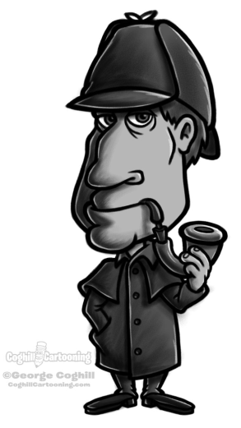
Ethical naturalism: Does this support Sherlock Holmes solving a mystery? Does it apply with morality?
This means the view that ethical or moral claims can be proved true by reference to facts about something in the real world.
It takes a scientific approach to ethical knowledge by saying that moral claims can be tested and proved in the same way that scientific claims can be.
According to ethical naturalism, the rightness or wrongness of particular actions is a fact of the universe in the same way that the boiling point of water is a fact.
Notes:
Explanation. By this point, students should be given a handout of the ppt slides so they can make notes as I talk around and expand on the notes on the slides.

Slide 8
Ethical naturalism
It is cognitive because it claims that ethical or moral claims can be known and proved.
It is realist because it depends on a relationship with the real world which exists.
It is empirical because it can be tested and proved by experience or experiment.
It means that morality is objective because it has a relationship with something real and does not depend on feelings, preferences or situations.
It means that ethical statements are propositions because they are a meaningful declaration of a fact about ethics.
Notes:
Stress that this level of detail is important.

Slide 9
e.g. ‘kindness is good’- Does this apply with this Thai advert?
An ethical naturalist would claim to prove that kindness is good by our experience of kindness and its effects in the real world.
We know what kindness is and we know that it happens. We understand what sort of thoughts and actions are kind. We understand the effects of kindness. We know all of this because of our experience of the real world. Therefore the claim that kindness is good can be proved by reference to our experience of the world.
If the claim that kindness is good is proved by reference to objective facts (facts about the real world) then ‘kindness is good’ must be an objective statement, since it is linked to an objective fact about the world.
Notes:
Talk through the example. Can students do the same thing with the statement ‘cruelty is bad’?

Slide 10
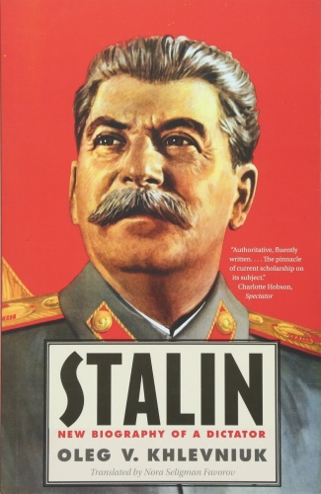
e.g. ‘Stalin was a good person’
An ethical naturalist would say that this statement can be proved wrong from our experience of the real world.
Evidence of Stalin’s role in the deaths of millions of Russians, his political purges and his personal cruelty prove that he was not a good person.
Ethical naturalism therefore also claims that moral statements can be denied based on our experience of the real world.

Slide 11
Utilitarianism
Based on the claim that it is good to maximise happiness and minimise suffering.
This claim is based on the fact that humans are motivated by the pursuit of pleasure and the avoidance of pain. This is a fact that we can experience in the real world. Therefore it can be known (is cognitive) is based on reality (is realist) can be tested or experienced (is empirical) and is objective (linked to a fact about the real world).
In Rule Utilitarianism, we can make statements like ‘it is wrong to torture’ because from real-world experience we know that this causes suffering and we know from real-world experience that humans want to avoid pain.
The wrongness of torture is independent of opinion because it is based on hard facts that are provable.
‘Torture is wrong’ is therefore an ethical proposition. It is declaring something meaningful about torture.
Notes:
Point out that students can show wider knowledge by using the example of Utiltarianism here – conversely, they can now add to their knowledge of Utiltarianism that it is naturalistic and explain why. They will also be able to use criticisms of naturalism in evaluation of Utilitarianism if the opportunity arises.

Slide 12
The link between morality and non-moral concepts
Ethical naturalism links a moral element and a non-moral element and claims that the non-moral element proves the moral element.
In the case of Utilitarianism, the non-moral element is pleasure or happiness.
For an ethical naturalist, goodness = maximising pleasure
In NML, the non-moral element is human nature
For an ethical naturalist, goodness = acting in accordance with human nature
This means goodness is the same as maximising pleasure, or acting in accordance with human nature.
Notes:
Important to stress this point as it is attacked by GE Moore.

Slide 13
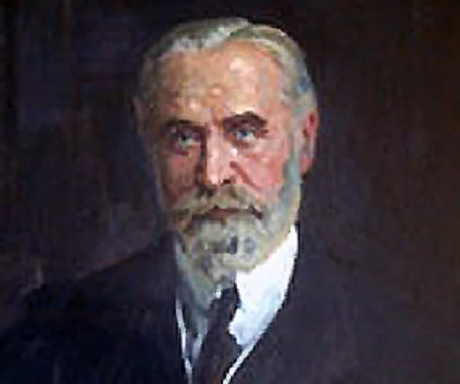
F H Bradley
19th Century philosopher.
Concerned with understanding the meaning of human existence.
Part of this was a study of what sort of ethics humans should pursue.
Presented his ideas in a book called Ethical Studies in 1876.
The book was written in a dialectic style – this means, writing about one view (the thesis), then about an opposite view (the antithesis), then combining the two (synthesis).

Slide 14
First, Bradley considered ethical Hedonism (Utilitarianism). This is a Naturalistic theory because it is based on evidence that humans pursue pleasure and avoid pain. Bradley liked the naturalistic basis of the theory but thought that the view that we are engaged in the pursuit of pleasure was too individualistic a view of humanity. He thought it could not fulfil us.
He then considered Kant’s duty based ethics. This is the idea that we can logically work out what our duty is by thinking about questions like ‘Would it logically make sense for everyone to behave in the same way?’ Once you know what your duty is, you must follow it without exception. This is an a priori and deontological system of ethics. Bradley liked the idea of duty, but did not like the idea that it was all worked out in the mind with no reference to the outside world.
Bradley combined the two by giving the idea of duty a reference point in the real world.

Slide 15
FH Bradley: My station and its duties
Bradley argued that our place within the community can tell us what our duty is and this will help us towards self-realisation.
Fulfilling our duty within society helps us to realise our true self.
We put ourselves in the context of our place in society and use that to help us to know our duty.

Slide 16
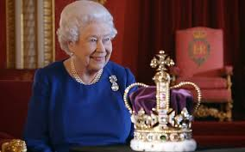
Example – the Queen
Her station in society is to be the constitutional leader of the country.
This involves a neutral political position – so she has a duty to keep her personal views out of public view.
It involves a responsibility to ensure the country is properly governed in the interests of the people – so she has a duty to be well-informed about what is going on and to question and advise politicians about what they are doing.
It involves putting the interests of her people first – so she has a duty to set aside personal concerns and act in the wider interests.
It involves representing the country on the international stage – so she has a duty to meet with world leaders, entertain and make them welcome, be polite and interested in everyone she meets, irrespective of personal feelings.

Slide 17
Naturalistic features of Bradley’s ideas
Ethical statements are propositions – they are meaningful (they link to something real)
Ethical statements are cognitive – they can be known and proved by reference to facts about the world (our station and its duties)
Ethical statements are empirical – they can be tested through experience and experiment (do they fit in with our station and its duties?)
Ethical statements are objective – because they are based on external facts, they are not dependent on personal feelings or opinions.
Ethical statements are propositions because they are factual claims which can be shown to be true (if they fit with our station and its duties).

Slide 18
To sum up Bradley’s ideas
He considered how we can pursue self-realisation.
He thought that an individualistic approach was not the way.
He thought that self-realisation involved fulfilling a duty to society.
He thought that Kant’s duty-based ideas did not have a connection to the real world as they were discovered ‘a priori.’
He thought that we must discover our duty to society by referring to our place within it.
Our duty comes from our place or ‘station’ in society.
By working hard and being obedient to the duties of our station, we can achieve self-realisation.

Slide 19
Bradley said

Slide 20
G.E Moore
Moore argued against ethical naturalism and called the attempt to identify goodness with a natural quality a mistake. He said that to claim that moral statements can be verified or falsified using evidence is to commit to the naturalistic fallacy. –SO WHAT IS GOOD?
Moore stated that whenever a philosopher attempts to prove a claim about ethics by appealing to a definition of the term 'good' by using a natural property such as 'pleasing' or 'desirable' they are committing a naturalistic fallacy.
Naturalistic theories of ethics attempt to define good in terms of something which can be identified in the world or in human nature - e.g. claiming that what is natural is good, or what makes us happy or healthy.
> there is nothing intrinsically good about happiness or health! they are only good is we define them as good.
If we adopt this approach, we effectively move from an 'is' to an 'ought' which HUME claimed was logically impossible
> an 'is' can be discovered by science, philosophy or reason
> an 'ought' is a judgement which can be achieved by consensus.

Slide 21
G.E Moore
Good is a simple, unanalysable property, just as a primary colour is.
> Moore's adapted version of utilitarianism says that right acts are those which produce the most good, but he said that good cannot be identified with some natural property such as pleasure; goodness cannot be defined.
- we cannot use our senses to tell whether something is good but we can use our 'moral intuition' and so we can still say whether a moral statement is true or false
> we recognise goodness when we see it! we just know if something is good.
> he called this a 'simple notion' and explained it by saying it is rather like trying to define the colour yellow - just as we cannot explain what 'yellow' is by means of definition, but only by showing an example, we can only explain what goodness it by example, not definition.

Slide 22
David Hume: Hume’s Law (the is-ought problem)
Moore argues it would be fallacious to explain that which is good reductively, in terms of natural properties such as pleasant or desirable. Moore's naturalistic fallacy is closely related to the is–ought problem, which comes from David Hume's A Treatise of Human Nature (1738–40).
Is Ought. The is-ought fallacy occurs when the assumption is made that because things are a certain way, they should be that way. It can also consist of the assumption that because something is not now occurring, this means it should not occur.

Slide 23
GE Moore: The Open Question Argument (moral facts cannot be reduced to natural properties)
Moore's argument attempts to show that no moral property is identical to a natural property. Moore further argued that if this is true, then moral facts cannot be reduced to natural properties and that therefore ethical naturalism is false

Slide 24
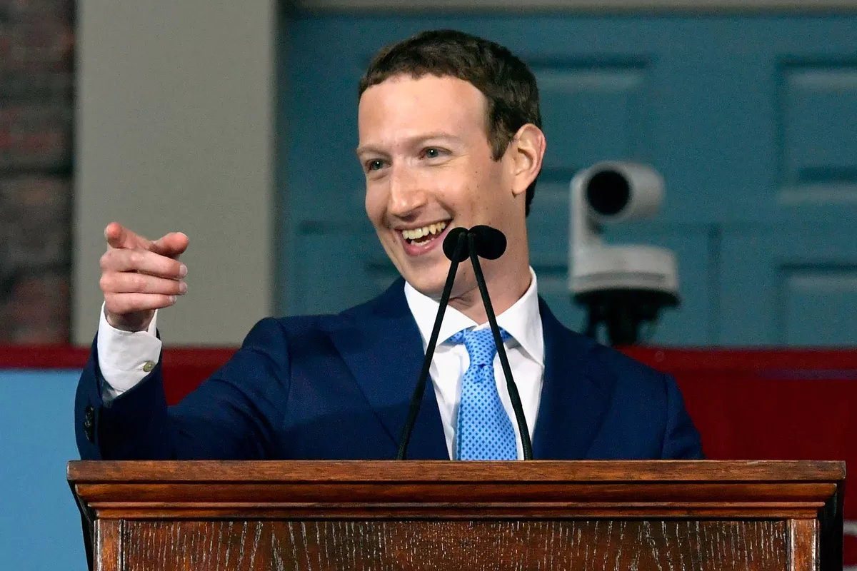
Independent work
1, Take the statement ‘kindness is good’. Explain why it is
Cognitive
Realist
Empirical
Objective
A proposition
2. Using Bradley’s ideas, what duties might Mark Zuckerberg have, according to his station in society?

Slide 25
Naturalism
(a) Explain the meta-ethical approach of Naturalism. [20]
(b) ‘The Naturalistic Fallacy illustrates that ethical language can never be objective.’ Evaluate this view. [30]

