Slide 1
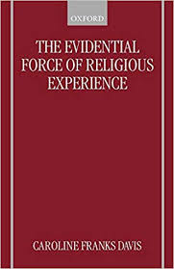
T4 C: Challenges to the objectivity and authenticity of religious experience
Caroline Frank Davis 1989 Evidential Force of Religious Experience

Slide 2
Description-related Challenges
When any event is described that claims itself to be an experience of God/Divine then a claim is being made for which there is no proof.
The is experience is inconsistent/contradictory with normal everyday experiences, its not valid and a misunderstanding of the recipient.

Slide 3
Subject Related Challenges
The recipient is unreliable as a source; they can be suffering mental illness, delusions, substance misuse. Therefore there is mistrust of their experiences and the claims are then dismissed.

Slide 4
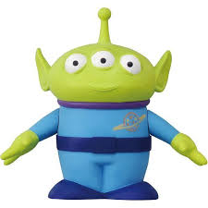
Object-related challenges
The suggestion of God having been experienced is no more likely than a claim of having seen an alien. Why should we believe someone who has seen God?

Slide 5
AO1 Activity:
Learn a specific category of challenge Frank-Davis. Research specific examples and share your understandings.

Slide 6
Further Debates about the Challenges: the very nature of mystical experiences, the criteria is impossible to verify. The very nature of mystical experiences are subjective not objective .
Scientific Empiricists tend to reject subjective accounts, religious experiences poses a serious challenge to the ‘truth’.
However for the individual/group it remains valid.
If the event is individual or has reoccurred the experience is still invalid.
Vienna Circle/Logical Positivists helped to clarify our understanding of religious language. Mystical experience may seem an ordinary claim but lacks any empirical to support it, neither experiences are priori or posteriori and therefore are meaningless.

Slide 7
Further Debates about the Challenges: the very nature of mystical experiences, the criteria is impossible to verify. The very nature of mystical experiences are subjective not objective .
Antony Flew Falsification principle stated propositions could be meaningful if there were some evidence against them. Religious believers allow nothing to count against their beliefs , then all religious statements were meaningless. John Wisdoms’ Parable of the Gardener. Flew thought that a religious believer could offer a reason why no evidence could be found to count against their own beliefs, religious experiences are essentially ones where there are no clear and agreed upon criteria, considered meaningless.

Slide 8
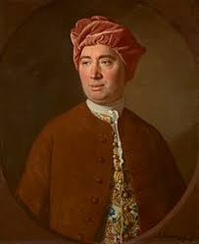
Further Debates about the Challenges: the very nature of mystical experiences, the criteria is impossible to verify. The very nature of mystical experiences are subjective not objective .
Hume ‘An Enquiry concerning human understanding’ (1748) stated it was not impossible that miracles occur, it was merely impossible to ever prove that one in fact had occurred. Due to highly individual nature of religious experiences , these experiences are not open to rational enquiry.

Slide 9
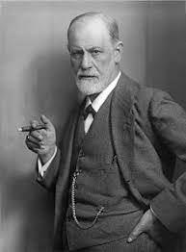
Further Debates about the Challenges: the very nature of mystical experiences, the criteria is impossible to verify. The very nature of mystical experiences are subjective not objective .
Ioan Lewis: close intelligible connection pre-industrial societies between religious ecstasy and need for group/individual to
legitimise.
Freud help religious experiences are repression sexual urges
Religious experiences have resemblances to effects like dugs
such as alcohol, LSD.
Swinburne- credulity: what someone claims to perceive is probably the case unless there are special reasons for thinking the experience is false. Four reasons that might cast doubt on the validity of the event: unreliable, similar perceptions are shown to be false, strong evidence that the object of the experience are not present, did not exist, event experienced can be accounted for in other ways as a reality and not just in your imagination.
Swinburne: Principle of Testimony, provides good reason to believe their religious experience is valid , it is probable believe the experience of others are they report as them to be.

Slide 10
AO2: The extent to which the challenges to religious experience are valid
Religious experiences are not the same as sense experiences
David Hume: direct experience of God is impossible
Logical Positivists religious experience cannot be verified.
Science provided challenges
To experience God in a non-physical body – challenge obvious limitations.
God wants to interact with his creation.
Religious experiences are shared by many so cannot be fabricated.
Neurological changes perceive a spiritual reality. Persinger’s Helmet (Dawkins) and claimed it did not produce any sensation of religious experience.

Slide 11
Challenges to religious experience are valid can accurately account for them

Slide 12
Challenges to religious experience are valid but have their limitations

Slide 13
Challenges to religious experience are valid because they have been adequately responded to

Slide 14
Challenges to religious experience are valid but so too are possible counter-arguments

Slide 15
Challenges to religious experience are valid but the answers and explanations of the phenomenon of religious experience are still uncertain.

Slide 16
The persuasiveness of Franks Davis’ different challenges
First Challenge: Claim of God is no proof, religious experience misunderstanding on the part of the recipient.
Second Challenge: recipient is unreliable (mental illness)
Third Challenge: Experience is seen as untrue.
Limit understanding of experience, this is not a everyday experience.
Swinburne principles testimony credulity, we experience it so therefore its true or testimony that is true.
The experience is rooted in te spirituality.

Slide 17
Franks Davis’ different challenges are persuasive in that they recount and highlight some of the central problems with religious experiences.

Slide 18
Franks Davis’ different challenges are not persuasive at all as there are many responses that have been given to them

Slide 19
Franks Davis’ different challenges are really an amalgamation of general challenges to religious experiences that have already have been debated.

Slide 20
Franks Davis’ different challenges are persuasive for those who already assume that there is nothing beyond the material real, that is, they are materialists.

Slide 21
Franks Davis’ different challenges are not persuasive because the have a clear materialistic basis and allow no possibility of religious experience in the first place.

