Slide 1
Theme 4: Religious Language
E: Religious Language as Non-Cognitive and Mythical

Slide 2
Complex form of mythical language that communicates values and insights into purpose of existence
Today, the myth is often seen as false. In Religious Studies, myth actually a highly specialised term refers to accounts and contain truths which are communicated in a form of picture imagery and symbolic text. To deconstruct is empirically, we would miss the accounts. Reductionist approach, led to popular view myths were more than fantasies which provides simplistic views of the world. Sitz im Leben is situation in life, relevant at the time. Myths relevant to culture such as creation stories, heroic myths.
If myths are similar ex nihilo: creations myths start with voids, water or the divine. Beliefs are rooted in culture but interpretations differ, they hold lasting truths about the culture. Mythical language if taken literally is an error.

Slide 3
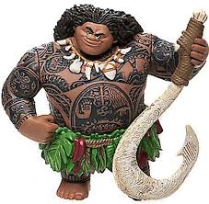
Creation Myths: comes out of ex nihilo (out of nothing)
Genesis: Creation. ‘vastness of emptiness (void)’ were seen as chaotic. But then bought under control by a God, then God of the myth who has the ability to conquer chaos can also bring land, fish , skies, bringing light into darkness and causing an order where life can flourish.
Philip Freund Myths of Creation 1964: similarity of other myths Sun-Father brings about creation from the waters of divine before humankind.
Maori New Zealand (PLAY) , demigod Maui pulled up the islands of New Zealand from the depths of the Ocean.
Tillich: ‘Myths are always present in every act of faith, because the language of faith is the symbol … it puts the stories of the God’s into the framework of time and space although it belongs to the nature of the ultimate to be beyond time and space’.

Slide 4
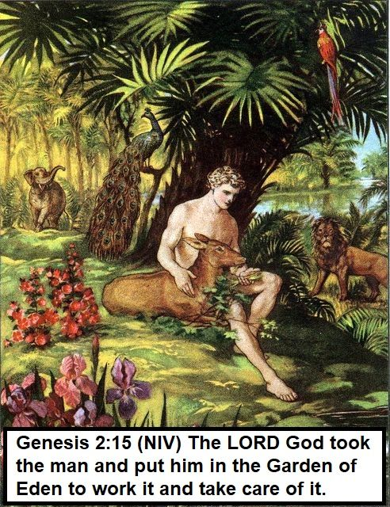
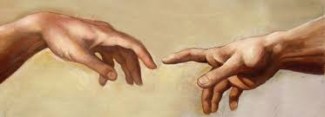
Creation Myths: comes out of ex nihilo (out of nothing)
‘Let us humankind in our image’. Through mythical language we are stewards that look after the Earth. It provides the insight into the purpose of existence. The language of myth provides non-cognitive , deeper understanding.

Slide 5
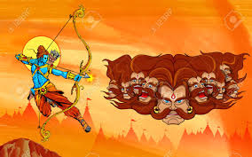
Heroic myths and myths of good against evil
Moomen : ‘Myths explores the deeper inner questions and problems that trouble humankind’. The Solar hero is the source of all life across different cultures and religions such as Sun God Ra- Egyptians he as life-giving abilities. The cycle of seasons were rooted in Egyptian and Greek Gods. The archetype (solar hero –direct evolution Sun God) – the agent of order is destroyed by Chaos then bought back to life in a victory against enemies. For example Rama battles with Ravana to save Sita.

Slide 6
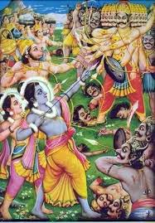
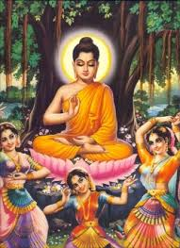
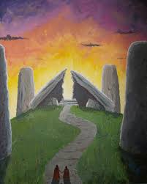
Heroic Myths Worksheet: How has the Solar hero shed light? How has it fought against darkness? How was the hero bought back to life to fight against evil? How is there a concept about the divine?

Slide 7
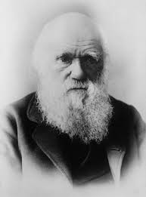
Challenges to myths and problems associated with them
Does the myth have integrity? Does it reveal truths? It is the foundation for society? How about competing truths such as Darwin’s Origin of the Species 1859. What happens when a myth predates Judeo-Christian myths? If the myth is not unique then does the religious claims not unique? The meaning of the myth may alter to fit the mood of the day, but destabilises the meaning of the myth.
Bultmann objects to myth because it tries to represent the divine the objective categories of the physical world… they are scientifically untenable in the world of lawful cause and effect. Bultmann rejects the mythological language of the NT as its unhelpful to the modern mind.

Slide 8
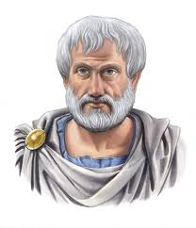
AO2: The effectiveness of the terms of non-cognitive, analogical and mythical as solutions to the problems of religious language
Words are abstract, vague; this was an issue to logical positivists. It cannot be verified or falsified.
If religious language is non-cognitive it cannot make factual statements, therefore sacred writings are the word of God- are asserted as the truth. How do we know God?
Competing myths, makes it unclear what is our purpose such as : are we play things of God?
Treat language cognitively is narrow. Non-cognitive expresses opinions and attitudes. Language is powerful and it has richness and depth.
Myths do not have to be taken literally but they are symbolic and convey meaning. Heroic myths inspire positive behaviour like Aristotle’s Virtue Ethics.

Slide 9
AO2: The relevance of religious language issues in the 21st century
Religious language comes under fire logical positivists, the statements cannot be verified.
Religious believers can find it difficult to articulate meaning of their own propositions – what constitutes meaning?
Popper, Randall, Tillich and Wittgenstein: meaningful in language .

